Slide 1
All about CELA: CELA orientation
CELA collections and services for public library staff

Slide 2
Learning goals
What is CELA and the role of libraries
Eligibility
CELA’s collections
Formats & services available to patrons and libraries
Registering for CELA
How to integrate CELA service at your library

Slide 3
What to expect in this webinar
Orientation webinar: overview of CELA services
Recommended resources:
Videos, webinar recordings, guides
Learning paths to meet staff needs

Slide 4
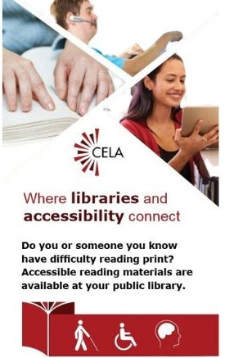
What is CELA?
Is a free library service offered through Canadian public libraries
Serves people with print disabilities across Canada
Provides materials in accessible formats, like braille, e-text and audio

Slide 5
Eligibility for CELA Service
The Canadian Copyright Act defines perceptual disability (learning, physical, or visual disability) as:
“a disability that prevents or inhibits a person from reading a literary work in its original format, and includes such a disability resulting from:”
Severe or total impairment of sight or the inability to focus or move one’s eyes,
The inability to hold or manipulate a book, or
An impairment relating to comprehension

Slide 6
Bookshare collection
Two collections in CELA’s catalogue:
  CELA
  Bookshare
Thousands of titles in digital formats
Requires Proof of Disability for patrons and Terms of Use form for educators

Slide 7

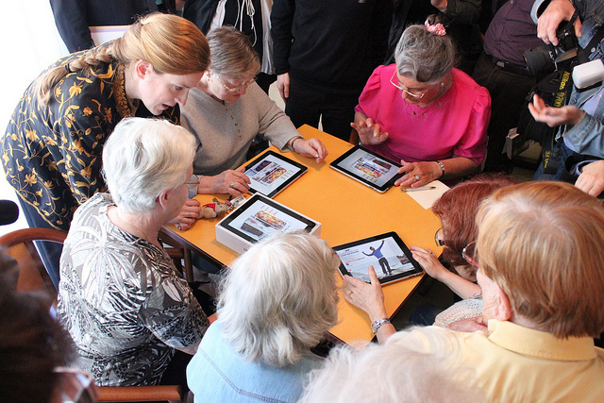

Who can access CELA’s collection
Patrons with print disabilities
On behalf of people with print disabilities:
  Public Libraries
  Educators
  Other professionals

Slide 8
Roles of public libraries in CELA service
Register patrons with print disabilities
Request books from CELA’s collection
Access CELA statistics
Promote CELA services in community

Slide 9
Value of accessible reading
“Having been legally blind for 3 years now has been a hardship that has, many times, discouraged and frustrated me. This service has been a game changer as the most important thing for me is to enjoy reading books with my 11-year-old granddaughter, Olivia!”

Slide 10

Book collections
Access to over 1.5 million items through CELA and Bookshare collections
Books for all ages, wide range of interests
English, French, other languages
New bestsellers every month
Canadian award winners, reading programs, Indigenous titles, disabilities

Slide 11



Equal participation in reading programs
Literary awards
Reading programs
Book clubs

Slide 12
Magazines and newspapers
Magazines
Audio: mostly Canadian titles for download
Popular e-text magazine titles
Subscribe to receive most recent issue
Newspapers
Daily popular international and regional papers
Read as e-text on a web browser

Slide 13

How patrons choose titles
Automatic selection service
Self-selection by logging into celalibrary.ca
Call or email CELA’s Contact Centre
1-855-655-2273 help@celalibrary.ca

Slide 14
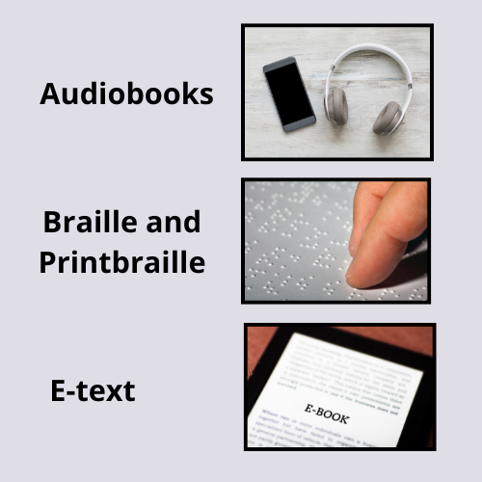
Accessible formats
DAISY audio
Braille and printbraille
E-text format:
  DAISY text
  ePub
  Word

Slide 15
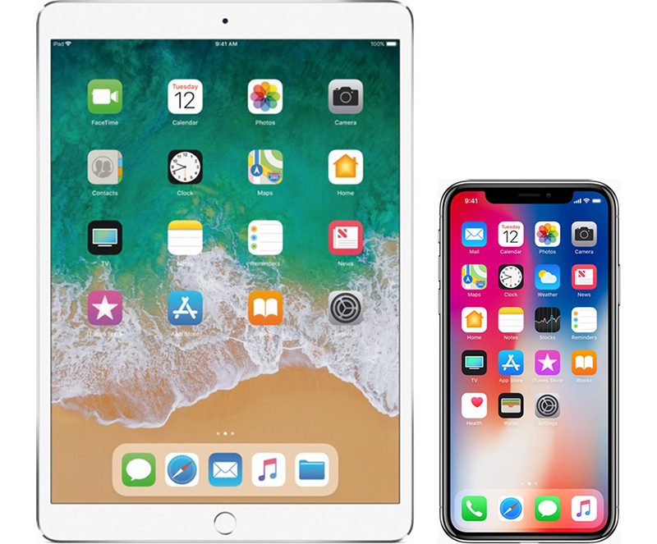
Does your patron have a…
Tablet, phone or computer?
Dolphin EasyReader app to read audiobooks or e-text
Delivery options:
  Direct to Player (loads books directly onto app)
  ZIP files

Slide 16
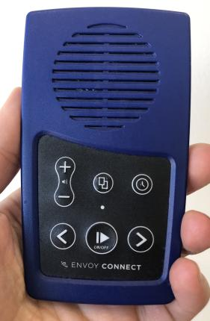
Does your patron have an…
Envoy Connect?
Audiobooks only
Direct to player bookshelf
Add/remove books by:
  Using the CELA Connect app on a computer
  Mail back player to CELA to reload

Slide 17
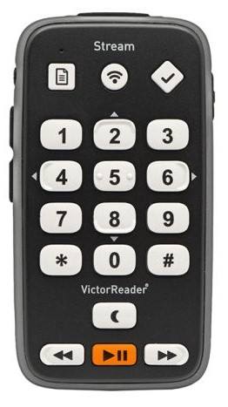
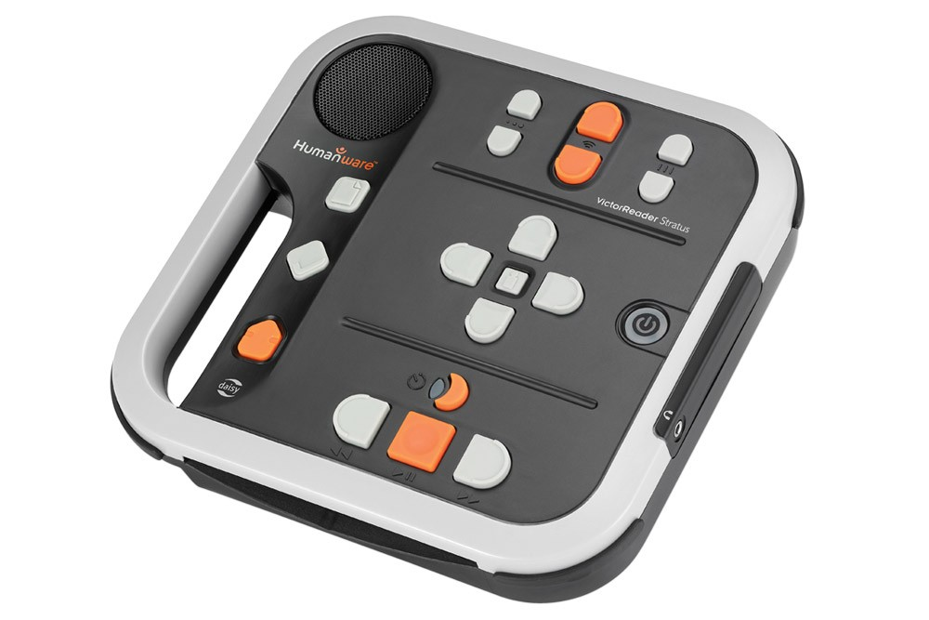
Does your patron own a…
DAISY player?
Humanware Victor Stratus or Stream
Audio and e-text
Delivery options:
  Direct to Player
  ZIP files

Slide 18
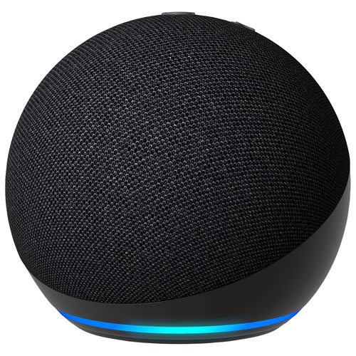

Does your patron own an…
Amazon Alexa Smart speaker:
Accessible Reading Canada Skill

Slide 19

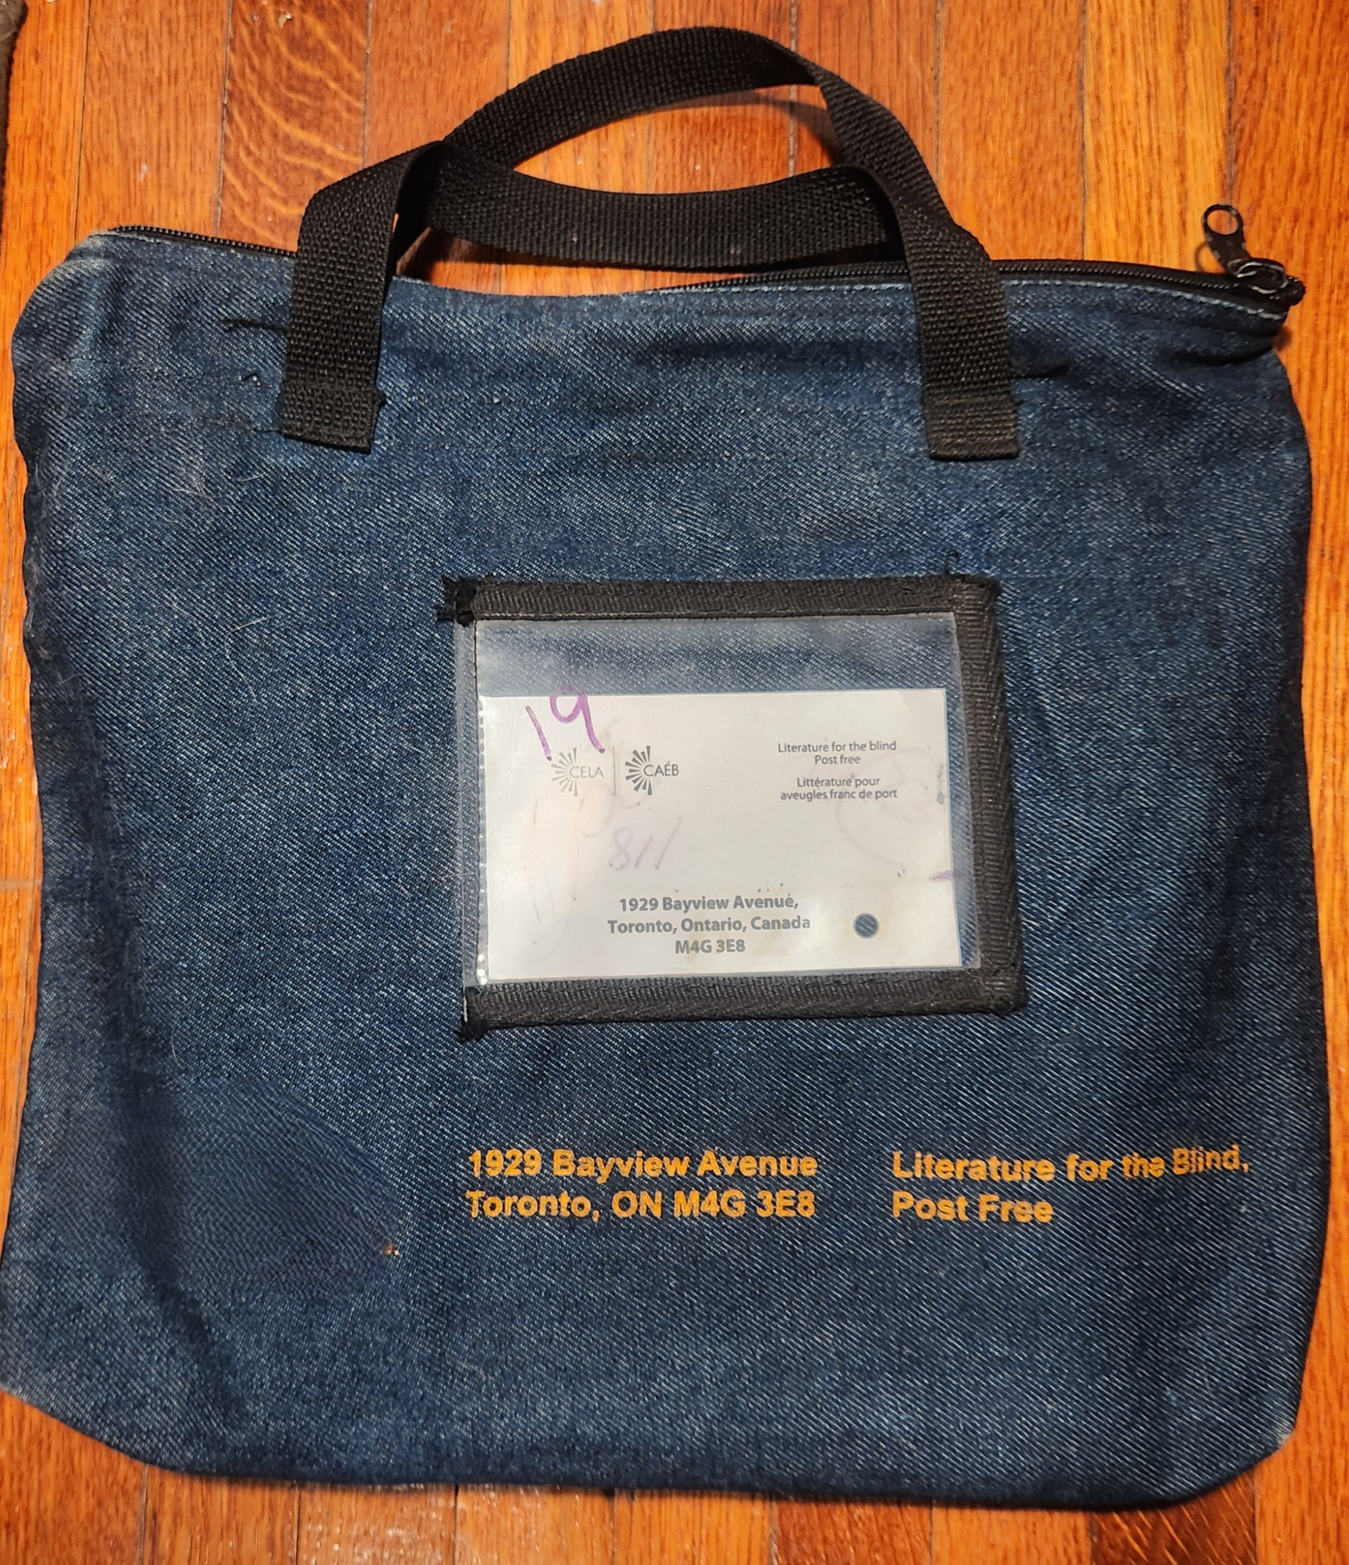
Mailing physical books
Braille
Shipped in boxes
Keep
Printbraille
Mailed in bags
6-week loan, must return

Slide 20

Registering eligible patrons
At the library:
Sign up for a library card.
Register for CELA celalibrary.ca/register
Vision Loss Rehabilitation client referrals
Self-registration with a library card: celalibrary.ca/self-registration

Slide 21
What happens after registering
Welcome email
Starter books
Call from CELA

Slide 22

More services for patrons and libraries
Assistance by phone or e-mail
Training webinars
Printable list of new titles
Monthly newsletter – Open Book / Livre ouvert and Open Book for Libraries / Livre ouvert pour bibliothèques

Slide 23
Integrating CELA at your library
CELA
Service
Programs
Outreach
Strategy
Staff
Books

Slide 24
Connect with CELA
Visit celalibrary.ca
Library customers with questions about their CELA service call or email: 1-855-655-2273 / help@celalibrary.ca
Library staff contact CELA Member Services: 1-855-655-2273, x2 / members@celalibrary.ca
Thank you!

