Slide 1
Transferring CELA materials
Workshop for library staff on transferring books and magazines to various devices

Slide 2

Land acknowledgement
I live and work in Montreal, which is on the unceded territory of the Kanien’kehá:ka people of the Haudenosaunee Confederacy. This land has served as a meeting place with many other Indigenous peoples of Turtle Island.
Wherever we find ourselves today, across Turtle Island, we can be grateful to the First Nations for their careful stewardship of the land.

Slide 3
Learning goals
What is CELA and eligibility
Ways to access CELA collection
Direct to Player vs. Transferring
When to opt for transferring
How to transfer to various devices
Where to find instructions

Slide 4
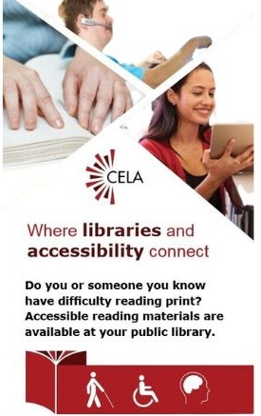
What is CELA?
Free library service offered through Canadian public libraries
Serves people with print disabilities across Canada
Provides materials in accessible formats, like braille, e-text and audio

Slide 5
Eligibility for CELA Service
The Canadian Copyright Act defines perceptual disability as:
“prevents or inhibits a person from reading or hearing a literary, musical, dramatic or artistic work in its original format.”

Slide 6
Print disabilities
The CELA collection is available for people with print disabilities. These include:
Severe or total impairment of sight or the inability to focus or move one’s eyes,
The inability to hold or manipulate a book, or
An impairment relating to comprehension

Slide 7
Ways to access the CELA collection
Library staff may support patrons with accessing CELA collection by:
  Helping patrons with their own account or device
  Loaning library-owned devices loaded with CELA materials
Digital materials can be accessed by:
  Direct to Player
  Manual download and transfer

Slide 8

Direct to Player vs. Transferring
Direct to Player
Transferring
1
Choose DAISY audio (Direct to player)
Choose DAISY audio (Zip)
1
2
Title appears on CELA bookshelf
VS
Title appears on Available ZIP files for download
2
3
Title on your bookshelf loads onto player
Download to device
3
Transfer to other device OR open in app
4

Slide 9
When to opt for transferring
Patron does not have Wi-Fi access at home
Cannot connect to library Wi-Fi
Using an app other than EasyReader
Using a different player (such as mp3 player)
Burning CDs
Using a braille display

Slide 10
How to download from the CELA collection
Always the first step for transferring
Demo on Windows PC
Basic steps
  Find book
  Select format
  Save file
  Unzip files (in most cases)

Slide 11
Demo: Download a title

Slide 12
How to transfer: DAISY players
Depending on device, transfer to:
  USB drive – 32 GB limit
  SD card – 32 GB limit
  Directly to device (12M, Stratus 2, Stream)
Transfer using Humanware Companion software or computer’s file explorer

Slide 13
Demo: Transfer to USB drive

Slide 14
How to transfer: Different apps
Download in desired format to device on which title will be read
Open in app of choice
  VoiceDream – mobile
  Thorium – Desktop
  Read&Write – Chromebooks, etc.
  Kobo

Slide 15
How to transfer: Burn to CD
DAISY audio from CELA can be burned to CD
  Use writable CDs, not DVDs
Basic instructions:
  Download the title from the CELA web page in the DAISY audio zip format
  Locate and unzip the zip file
  Open the folder containing the extracted book
  Select all files in that folder and copy them to the CD. Important! Do not copy the folder containing the book, only the files.

Slide 16
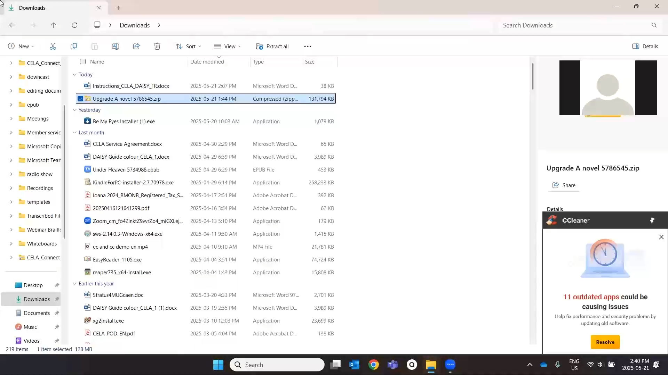

Demo: Burn to CD

Slide 17
Where to find instructions
Tutorials
  Downloading books
    How to download a DAISY book to your computer
  Transferring
    How to transfer a DAISY .zip book to your Victor Stratus
    How to burn a CELA DAISY audiobook or magazine to a CD

Slide 18
Connect with CELA
Visit celalibrary.ca
Library customers with questions about their CELA service call or email: 1-855-655-2273 / help@celalibrary.ca
Library staff contact CELA Member Services: 1-855-655-2273, x2 / members@celalibrary.ca
Thank you!

