Slide 1
Summer reading for everyone!
Make your library’s club accessible for kids with disabilities

Slide 2

Land acknowledgement
We live and work in Toronto, the traditional territory of many nations including the Mississaugas of the Credit, the Anishnabeg, the Chippewa, the Haudenosaunee and the Wendat peoples. This territory is now home to many diverse First Nations, Inuit and Métis peoples. This land is covered by Treaty 13 with the Mississaugas of the Credit.
Wherever we find ourselves today, across Turtle Island, we can be grateful to the First Nations for their careful stewardship of the land.

Slide 3
Learning goals
How to make your club inclusive from planning, delivery and evaluation
Why libraries should include accessible formats in reading activities
Accessibility considerations for clubs: tracking reading, giveaways and more!
Craft and activity ideas that are accessible

Slide 4
Story
“My little girl has diverse abilities and is embarrassed to read because she is in grade 4 with a grade 1 reading level. SRC has changed all of that to ‘proud of reading’! She even started reading in bed at night on her own with a flashlight – I cried tears of joy”
~Comment a Cambridge Public Library (ON)parent

Slide 5
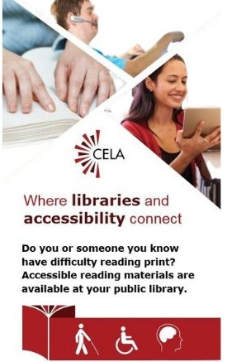
What is CELA?
Is a free library service offered through Canadian public libraries
Serves people with print disabilities across Canada
Provides materials in accessible formats, like braille, e-text and audio

Slide 6

Who can access CELA’s collection
Patrons with print disabilities
On behalf of people with print disabilities:
  Public libraries
  Educators
  Other professionals

Slide 7
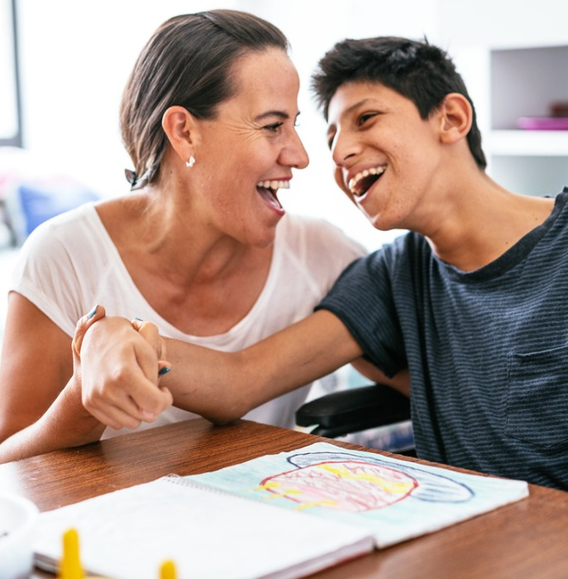
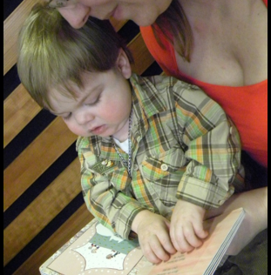
Types of disabilities
Visual
Physical
Learning
Mental Health
Developmental
Hearing

Slide 8
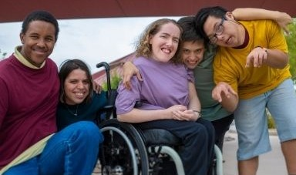
Born accessible
Accessibility is proactive
Easier to plan ahead than adapt on the fly
Inclusion and belonging

Slide 9
You’re already doing accessibility!
Communications
Neurodivergent adaptions
Build on what you're already doing

Slide 10

Nothing about us, without us!
Reach out to disability groups in your area
Invite them to your programs and events
Consult them on accessibility

Slide 11

British Columbia SRC
Recommended reading lists with books in CELA’s collection
Dyslexia considerations
Activity adaptation suggestions

Slide 12

BC SRC ASL Video

Slide 13


TD Summer Reading Club
Notebook formats: large print, audio, braille, and OpenDyslexic font
Accessibility pages
Audio versions of webcomic and StoryWalk
Disability representation

Slide 14
Promotions and outreach
Design accessible flyers, social media and online promotion
  Hashtags: #SummerReadingClub
Outreach
  Talk about the Club's accessibility features
  Promote reading in multiple formats
  Talk to people with disabilities!
    Promote the Club to local organizations, camps, etc.

Slide 15
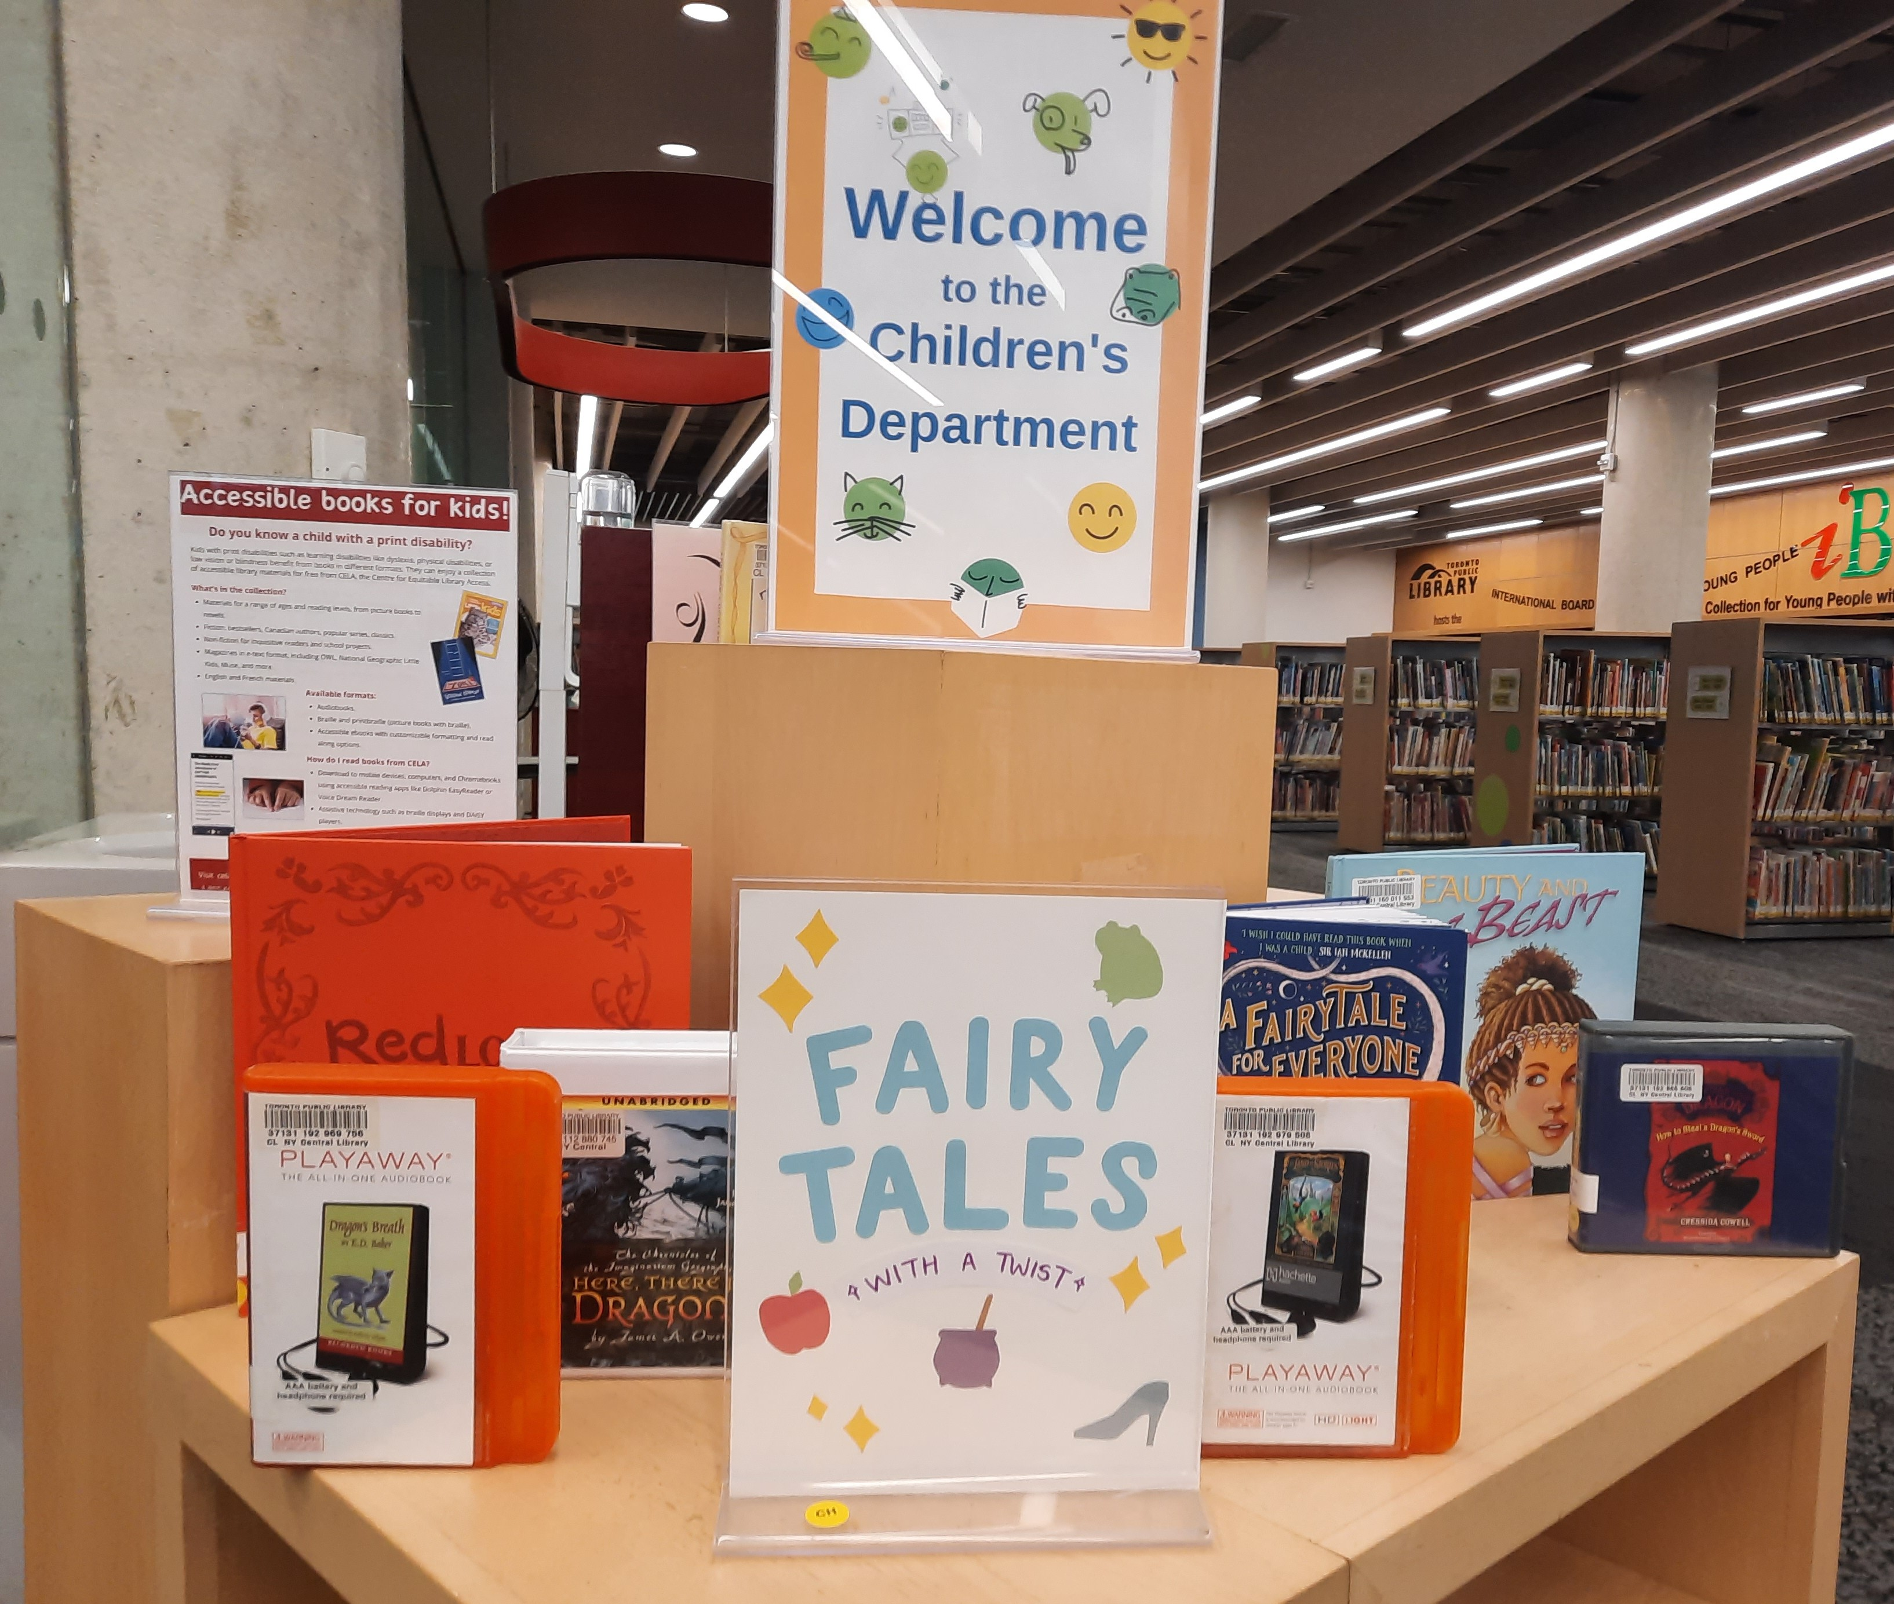
Displays and decorating spaces
Feature multiple formats
Keep it simple and don’t over decorate
Wheelchair height
CELA child services poster
Don’t put braille books behind glass

Slide 16
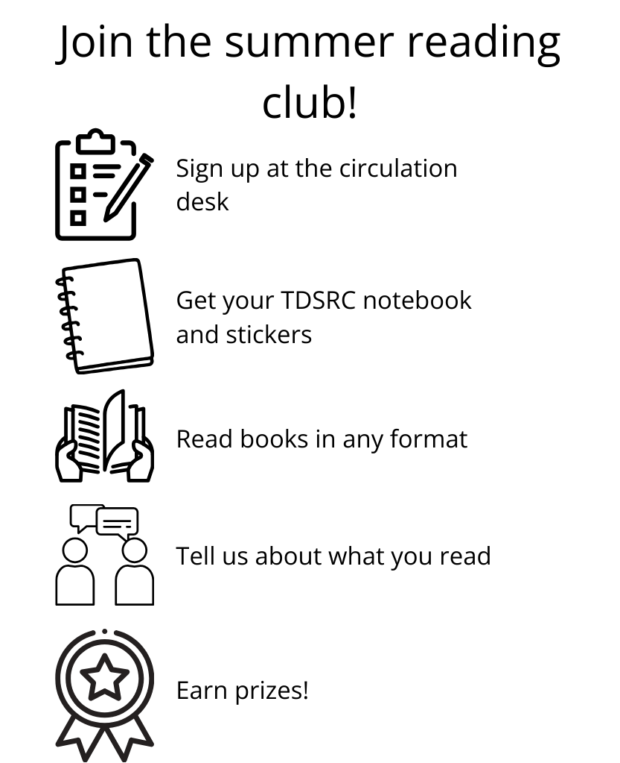
Registration
Keep it simple
Have signage for where and how to sign up
Use visuals
Provide accessibility information: accommodations, accessible collections, website, etc.
Offer seating

Slide 17
Book reporting
Counting time not titles
Count audiobooks, braille books and other formats.
Submit reports online or via email
  Virtual stickers
Offer creative ways to report, i.e., drawing, writing, verbal
Be flexible and ask a broader question if the child is struggling

Slide 18


Giveaways and prizes
Consider vision loss, mobility, etc.
Fuzzy, puffy, shiny stickers
Mini fidgets
Keychains—tactile, stuffed animals
T-shirts and water bottles
Experience-based prizes

Slide 19
Evaluations
Online and in print
Short and to the point (max. 5-7 questions)
Intro with explanation (anonymous, timing)
Offer text and visuals
Invite and record oral feedback
Ask an accessibility-specific question

Slide 20
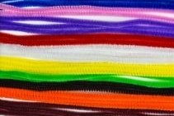
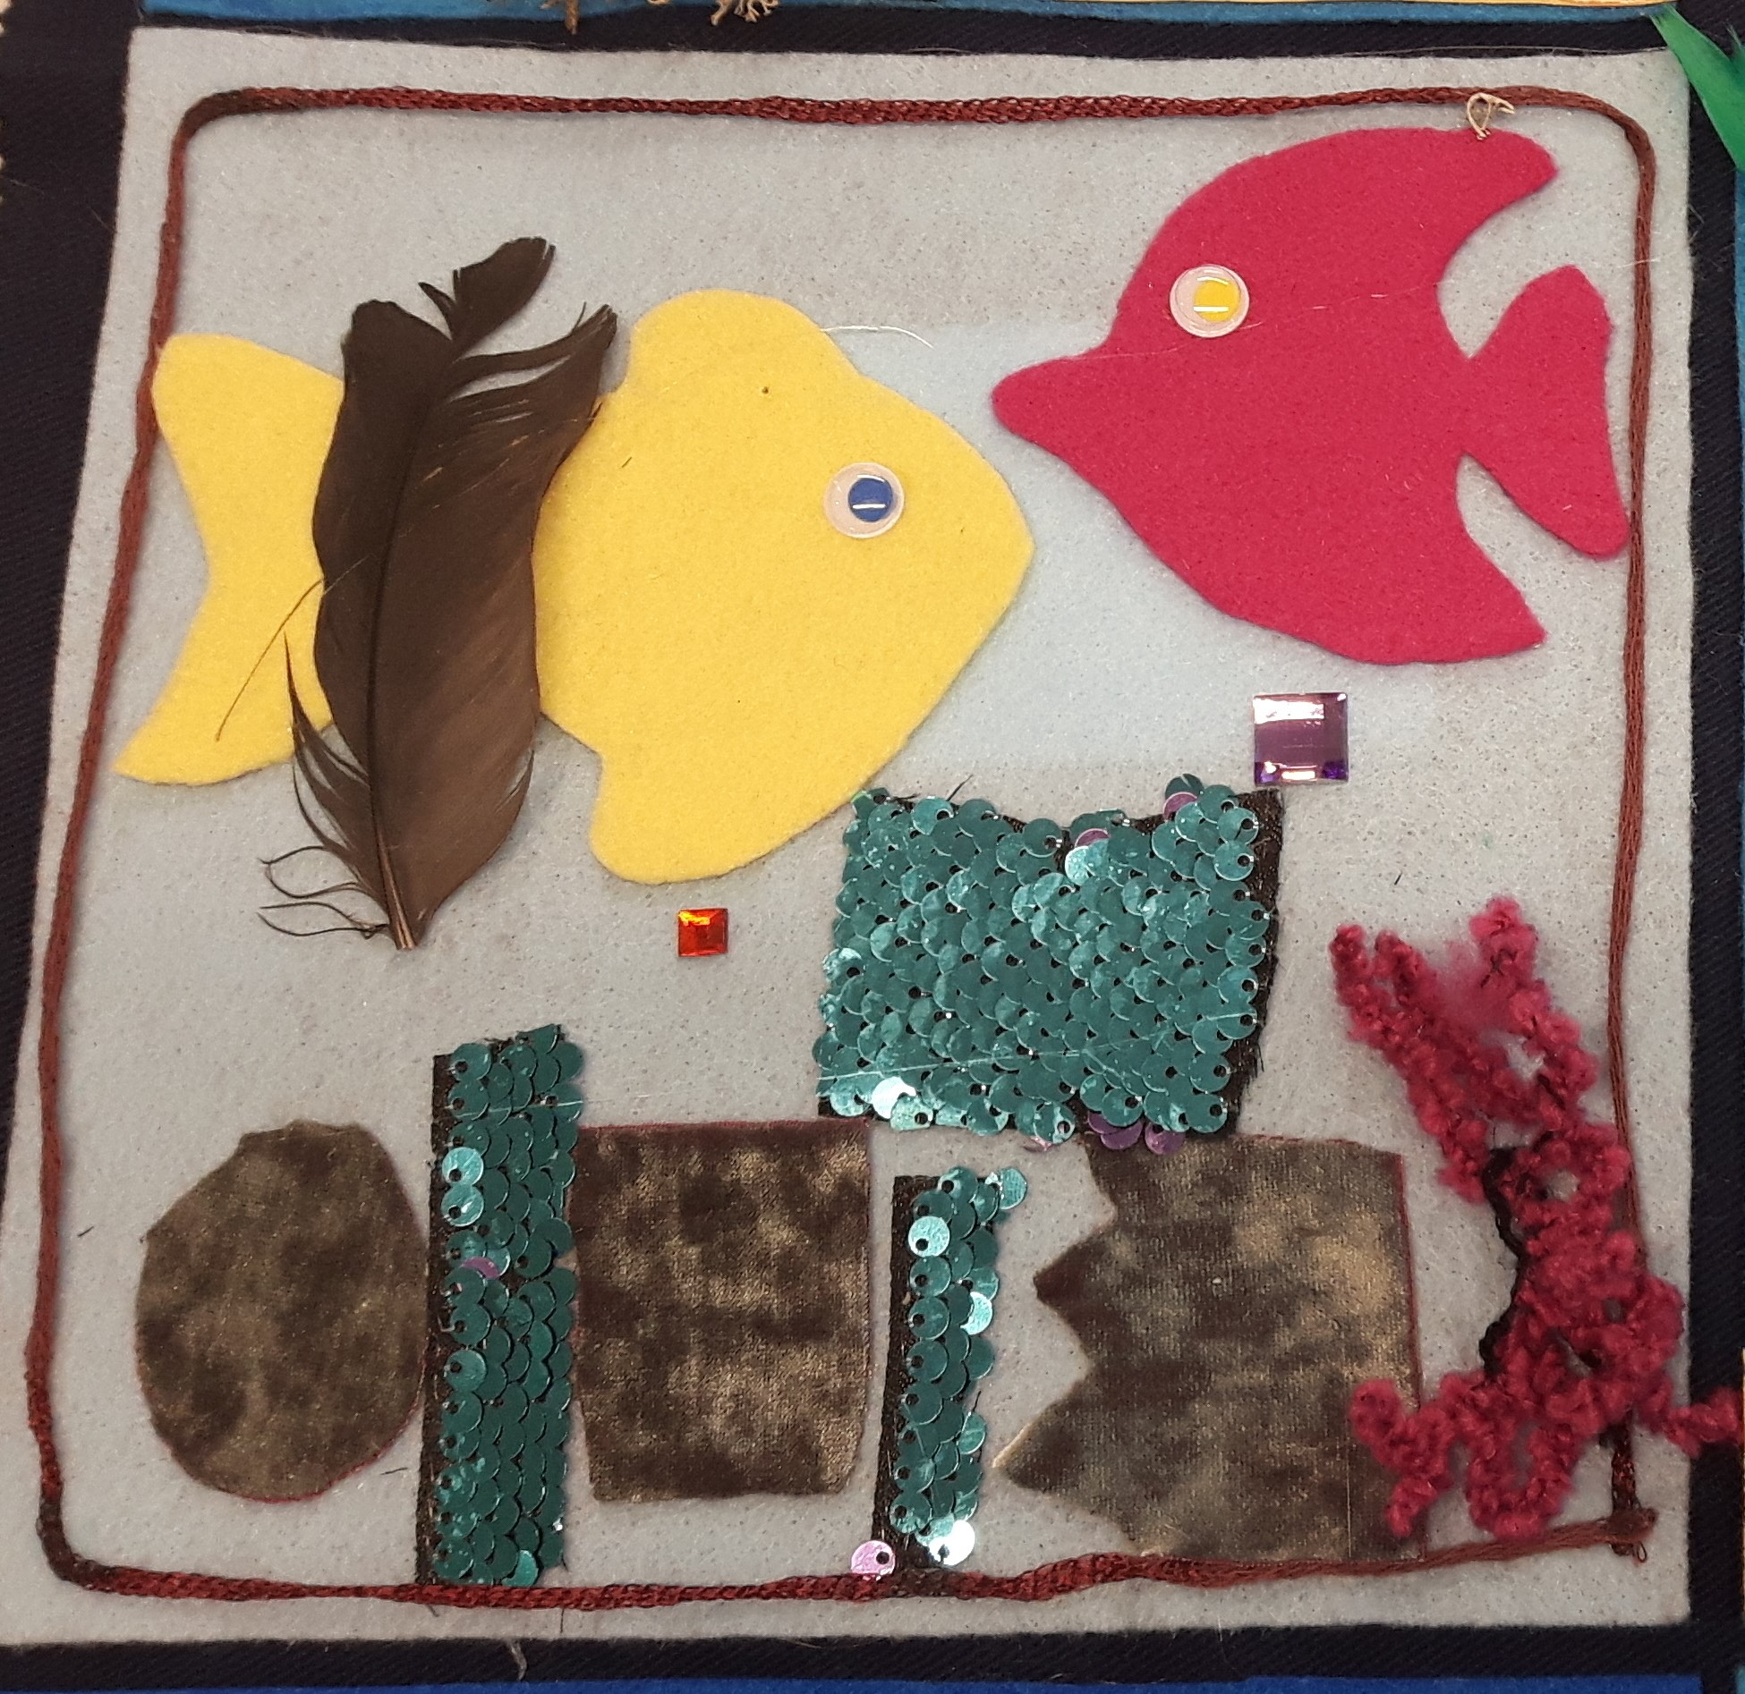

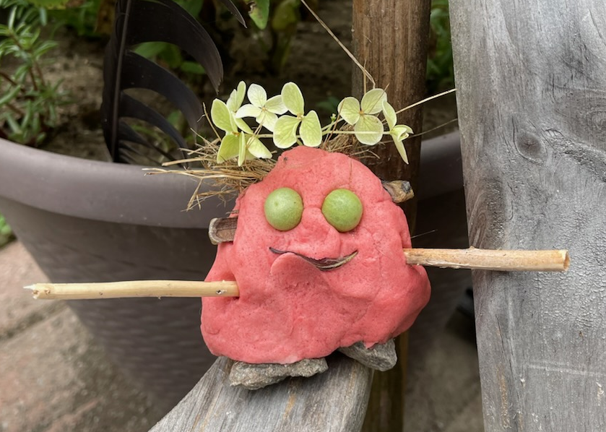
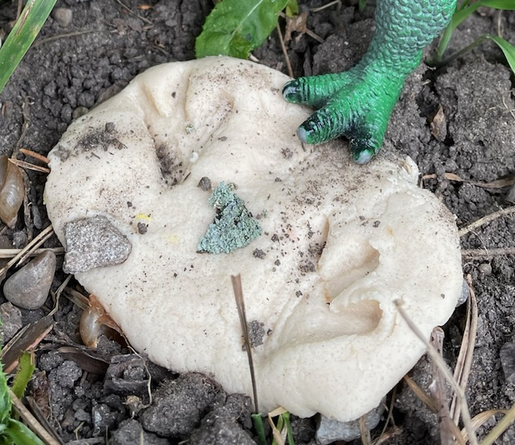
Programming: Crafts
Tactile Images
Trees from The Lorax
Compostable Creations
Play dough or salt dough
Monsters, creatures, fossils

Slide 21
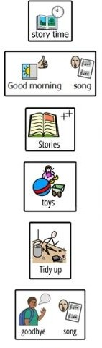
Programming: Storytime
Fidgets, headphones, sunglasses
Short stories with big bold illustrations
Wiggling and walking
Visual schedule

Slide 22
Programming: Large scale events
Launch parties, author talks, presenters
Microphones
ASL interpretation
Different types of seating
Ramp access to stage area
Quiet space

Slide 23


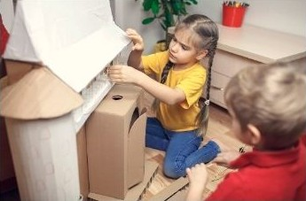
Programming: STEM
Slime, experiments, salt dough
Tactile maps
Recyclable material structures

Slide 24
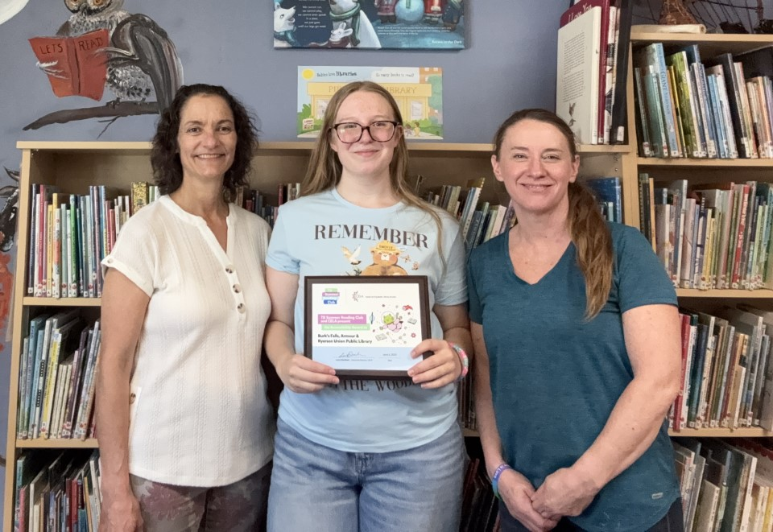
TDSRC Accessibility Award
Prize awarded to an English or French library that demonstrates a dedication to accessibility in their Club
$2,000 cash prize
Applications open towards the end of summer
Remember: you're already doing more accessibility than you think!

Slide 25
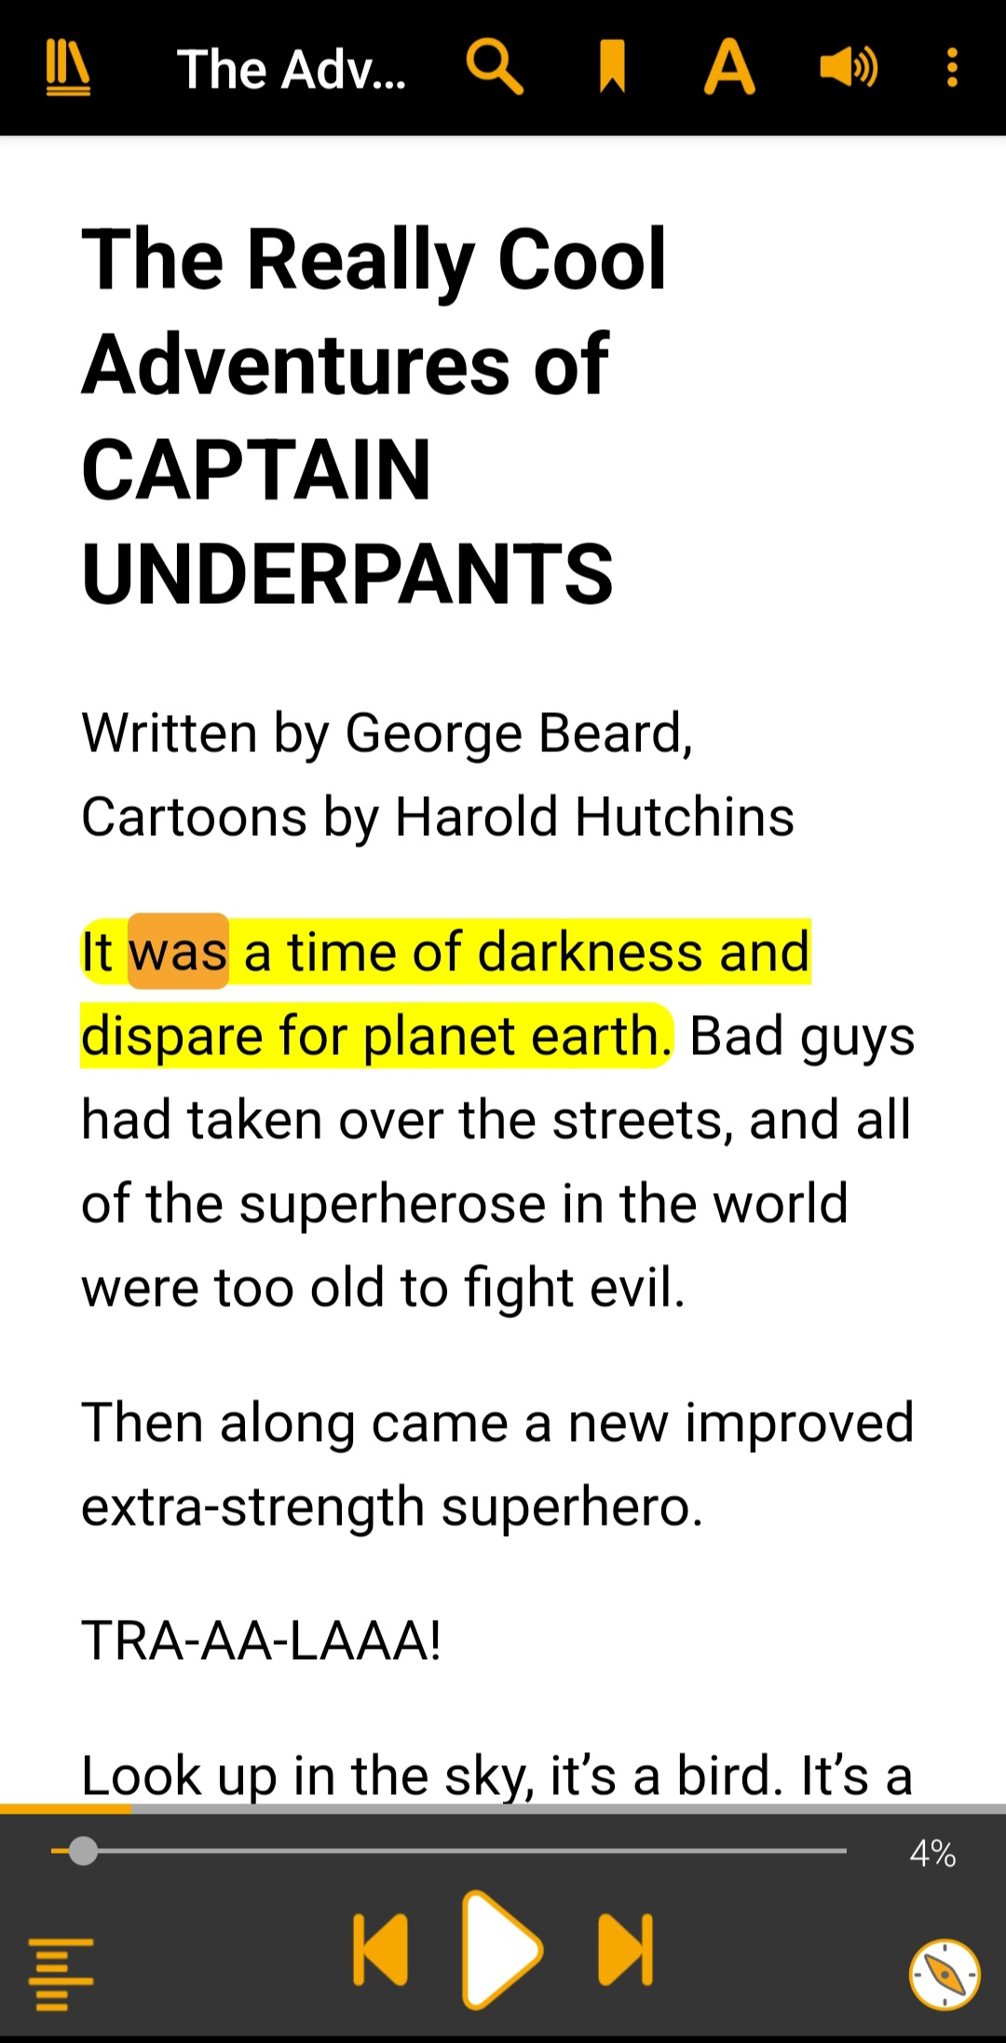
How CELA can help
Access books in accessible formats
Resources on CELA’s site
TDSRC Plan for Accessibility page

Slide 26
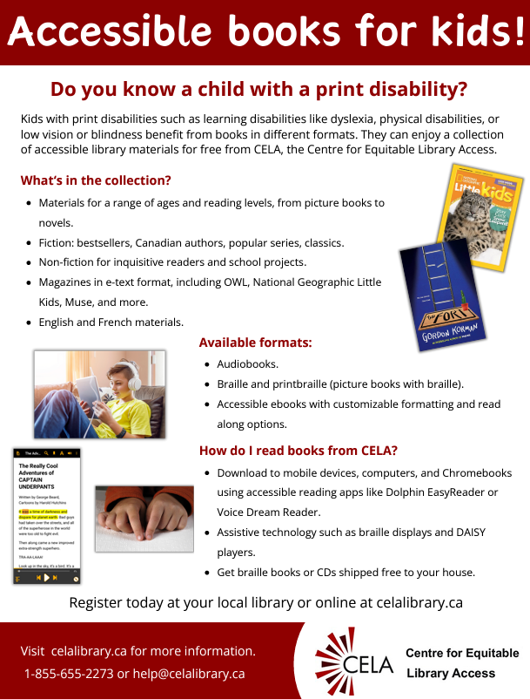
Resources
Accessible literacy resource guide
Accessible crafts and activities resource guide
Accessible storytime guide
CELA’s child services poster

Slide 27
Resources
Child and Teen Library Accessibility Interest Group!
Educator Access Group
Resources for Supporting Kids and teens with Disabilities page
Accessible Libraries (PLARC)
BC SRC Inclusion and Accessibility page
TDSRC Plan for Accessibility page

Slide 28
Thank you!
Denise Scott, Program Assistant
denise.scott@celalibrary.ca
celalibrary.ca 1-855-655-2273 ext. 2
members@celalibrary.ca

