Slide 1
Accessible Reading Canada
Listen to CELA Audiobooks with Alexa

Slide 2
Housekeeping
Introductions
Asking Questions
Accessibility Features in Zoom
Tech Issues
Webinar Recording
Survey

Slide 3

Land acknowledgement
I live and work in Nova Scotia, located in one of the seven districts of the ancestral and unceded territory of the Mi’kmaq People.
This land is governed by the Peace and Friendship Treaties which established ongoing relationships of respect, peace, and mutual obligation. These Treaties did not cede land, but affirmed that Mi’kmaq and settlers would live in harmony as Treaty partners.
We are all Treaty People, with a shared responsibility to uphold these agreements and share in our learning, respect, and work toward reconciliation.

Slide 4
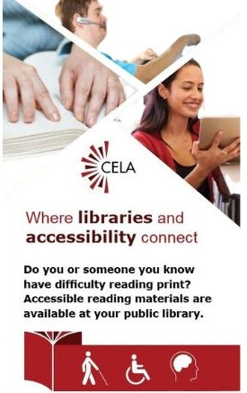
What is CELA?
Is a free library service offered through Canadian public libraries
Serves people with print disabilities across Canada
Provides materials in accessible formats, like braille, e-text and audio

Slide 5
Agenda
Alexa Smart Speakers
Accessible Reading Canada (ARC) Overview
How the Skill Works
How to get help
Questions

Slide 6

Remember to mute your device!

Slide 7
Alexa Smart Speakers

Slide 8
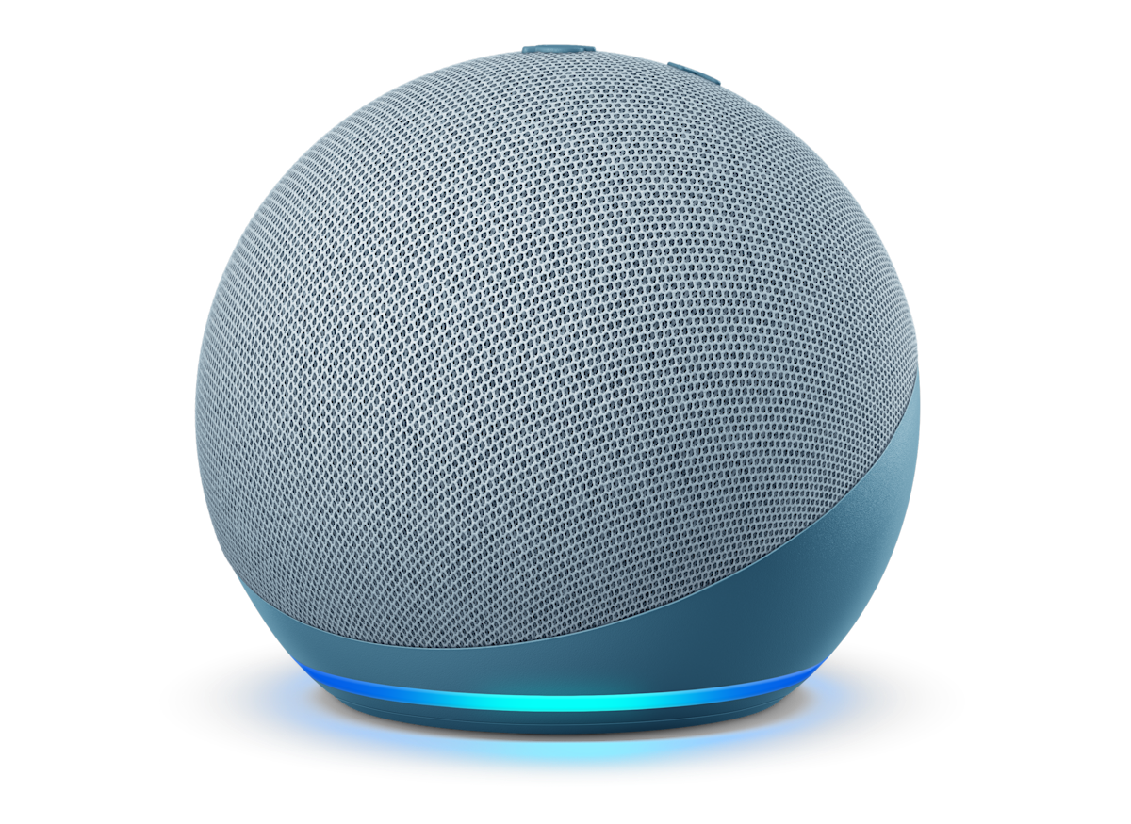
About Alexa Smart Speakers
A speaker that operates with Amazon’s voice-controlled assistant, Alexa.
Allows users to give voice commands to:
control music playback
manage smart home devices
get information
Most speakers range from $40-$100

Slide 9
Where to buy an Alexa smart speaker
Online retailers
  Amazon Canada website
  Newegg
Electronics retailers
  Best Buy
  Canada Computers
  Staples
Home Improvement retailers
  Canadian Tire
  Home Depot
Other retailers
  Walmart
  Shoppers Drug Mart / Pharmaprix

Slide 10
Accessible Reading Canada (ARC)

Slide 11

About Accessible Reading Canada
Alexa skills are voice-activated apps that add new functionalities to an Alexa-enabled device.
Accessible Reading Canada is a free Alexa skill that allows CELA users to read audiobooks on an Alexa smart speaker.
Available in English and French.

Slide 12
How Accessible Reading Canada Works

Slide 13
What you need
CELA account
Amazon.ca Account
  Only works with Amazon accounts created from the Amazon Canada website
Alexa Smart Speaker
  Configured in either English or French, not multilingual
Internet Connection

Slide 14
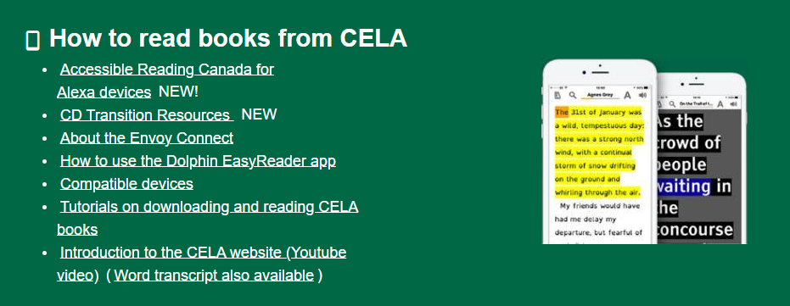
Help & Resources
How to navigate to the Accessible Reading Canada Help Page

Slide 15
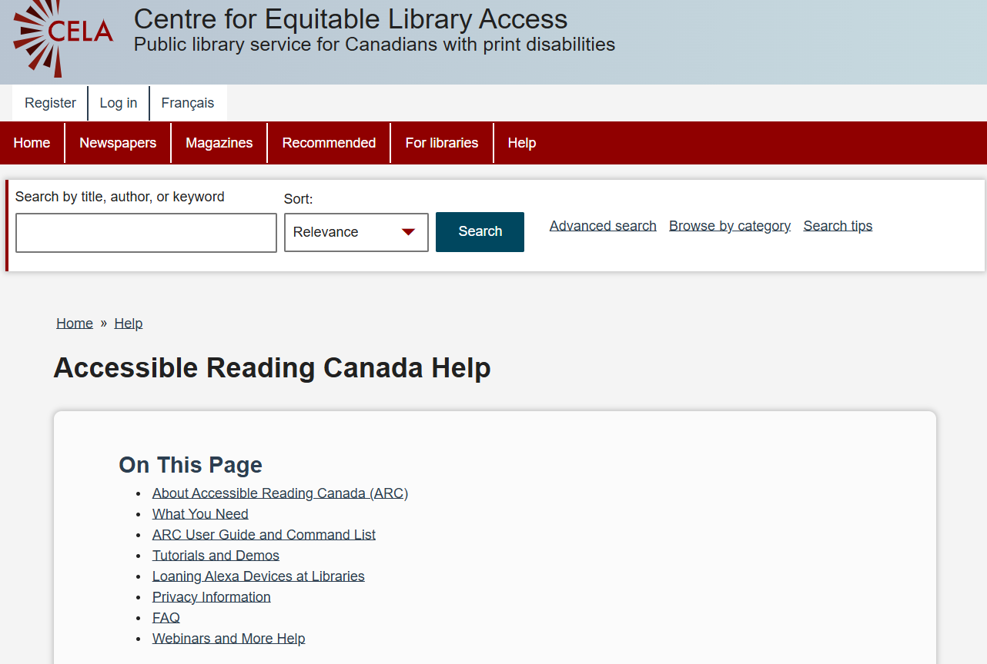
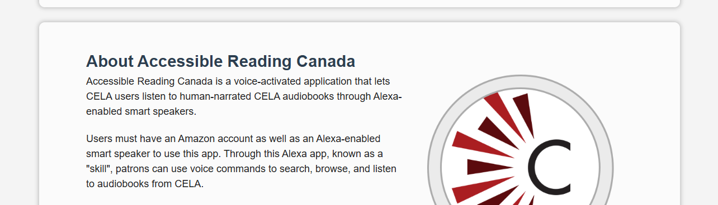
Accessible Reading Canada Help Page
How to read books from CELA
User Guide and Command List
Video Tutorials and Audio Demos
Information on Loaning Alexa Devices at Libraries
FAQ and more help
Notes:
Accessible Reading Canada Help Page: https://celalibrary.ca/help/accessible-reading-canada

Slide 16
Connecting to CELA
Launch skill
  Alexa app
  Amazon Website
Log into CELA account
Use command list to navigate skill
Notes:
Note: Users can change the launch phrase, using Alexa Routines. Instructions are on the Accessible Reading Canada help page.

Slide 17
How to add books to your bookshelf
Choose DAISY audio
(Direct to Player)
format
Title appears on CELA account bookshelf
User can access title on smart speaker via skill

Slide 18
Skill Menu
Resume Books
My Books
  Books in Progress
  Bookshelf
Browse Library
  Search
  Recommended Books
Notes:
Note: After entering Alexa’s playback feature, you must exit the audiobook playback before you can return to the skill.

Slide 19

1) Resume Book
Resumes your most recently played book
Playback
  Navigate chapters
  Increase volume
  Ask Alexa for info
Commands:
  Launch/Open
  Read/Resume
  Stop/Quit
Notes:
Note: Not all audiobooks will be able to navigate chapters. This is due to the audio file the CELA receives from publishers, not the skill itself.

Slide 20

2) My Books
Books in Progress
  Hear a list of up to 4 recent books you started reading to on the skill
Bookshelf
  Lists books on your CELA Direct to Player (D2P) bookshelf
Commands:
  Next/Previous
  First
  Repeat
  Main Menu
Notes:
Note: Users can use help command in any menu of the skill, except for playback.

Slide 21

3) Browse Library
Search
  Search for books by title, author, or title and author
Recommend Books
  Hear a short list of staff selected books
Commands:
  Search
  Summary
  Help
  Go back
Notes:
Note: The help command is contextual and will give you command options in any menu. For example, while searching, the help command will tell you how to complete a search.

Slide 22

Stacked Commands
Ask Alexa to perform sequential commands
“Alexa, launch Accessible Reading Canada and search The Hunger Games”

Slide 23
Accessible Reading Canada Review

Slide 24

What the skill can do
Play human-narrated books from CELA
Navigate tracks in order, using previous or next
Return to your where you were previously reading on smart speaker
Read book summaries
Perform ‘stacked’ commands
Move backwards and forwards in the menu structure and return to “Main Menu” any time

Slide 25

What the skill cannot do
Page or heading navigation
Adjust playback speed
Sync with other reading apps or devices (Victor Stream, Dolphin EasyReader)
Search is very basic, no filters
Read e-text, books from Bookshare or magazines
No ability to remove books from Direct to Player (D2P) bookshelf via skill

Slide 26
How to Get Help

Slide 27
Who can you call?
Amazon Support
CELA Contact Centre
Initial Smart Speaker setup help
Tech issues outside of the skill
Privacy-related questions
General questions about Accessible Reading Canada
Bug reports for the skill

Slide 28
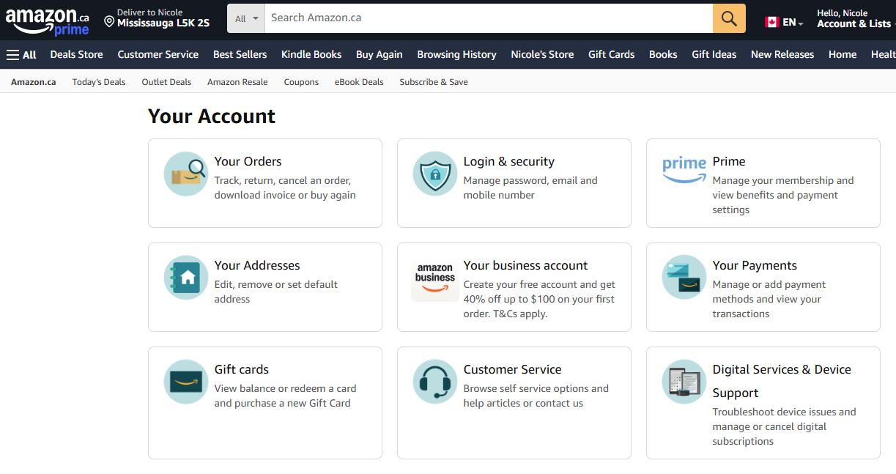
Amazon Support
Select Amazon Account on website (“Hello, _____”)
  Digital Services and Device Support
    Amazon Alexa Accessibility Help
  Customer Service

Slide 29

CELA can help!
Call our Contact Centre for 1x1 phone help
Join live training webinars
Check out the Accessible Reading Canada Help page
  User Guide
  Video Tutorials
  Audio Demos

Slide 30
Connect with CELA
Visit www.celalibrary.ca
CELA service call: 1-855-655-2273
CELA email: help@celalibrary.ca
Thank you!

Slide 31
Survey
Notes:
Note: Survey link will be sent in an email after the webinar is finished.

Slide 32
Questions

