Slide 1
How to support library patrons to read CELA’s audiobooks and magazines
Transitioning from reading on CDs to other devices

Slide 2

Land acknowledgement
I live and work in Montreal, the unceded territory of the Kanien’kehá:ka people of the Haudenosaunee Confederacy. This land has served as a meeting place with many other Indigenous peoples of Turtle Island.
Wherever we find ourselves today, across Turtle Island, we can be grateful to the First Nations for the careful stewardship of the land.

Slide 3
Learning goals
Which audiobook players work with CELA audiobooks and magazines
How to access CELA books and magazines on library-owned devices
How CELA can support book clubs and reading programs
Where to find help, training and tutorials

Slide 4
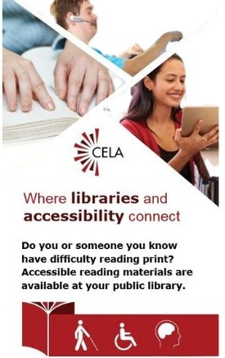
What is CELA?
Is a free library service offered through Canadian public libraries
Serves people with print disabilities across Canada
Provides materials in accessible formats, like braille, e-text and audio
Notes:
CELA is a comprehensive accessible library service, providing over 1.4 million books, magazines and newspapers to people with print disabilities living in Canada. CELA is a national not-for-profit organization that provides accessible reading services to the approximately 3 million people across Canada with print disabilities. Our services ensure that people with print disabilities across the country are more able to fully participate in learning, work and community life and contribute to the social, cultural, and economic development and success of their local and broader communities.
Our mission is to support public libraries in the provision of accessible library collections and to champion the fundamental right of Canadians with print disabilities to access media and reading materials in the format of their choice.

Slide 5
About CELA’s audiobooks
Wide collection of favourite authors, topics and in English and French
Audio magazines
Titles from OverDrive, Audible, etc.
Professional recordings including celebrity and author narrators
Notes:
Mostly Canadian titles for audio magazines
Get our audiobooks from commercial audio producers and other libraries like ours from around the world

Slide 6
Alternatives to CDs
CELA committed to reading device and format options
Audiobook and magazines on CDs ended July 31, 2025
All other services and formats remain the same
Notes:
We know many of your patrons enjoy receiving their books on disks that arrive at their home, or they get from your public library. While this format works well for many users, the fact is, recent shifts in technology, the marketplace and in our federal funding have required CELA to make the decision to cease production and distribution of audiobook CDs to all CELA users and CELA member libraries effective July 31, 2025. We understand how disappointing this news is to many of our users. We also know this news will require libraries to make changes to how they offer CELA audiobooks to their patrons who preferred CDs.
In our commitment to offering choice in terms of reading formats and devices, in 2023, we introduced a new player called the Envoy Connect as a new way to read our audiobooks. We’re also exploring a way to play CELA audiobooks on a smart speaker, particularly on an Amazon Alexa which I’ll describe in more detail later on.
We’ll continue our audiobook collection, as well as other formats including e-text, braille and printbraille.

Slide 7
How to start: your library’s CELA account
All CELA libraries have accounts
Use to order books for patrons, registration and view CELA usage statistics
Account types:
  Main CELA account (all libraries)
  Direct to player account (optional)
  Deposit account (optional and ended July 31)

Slide 8
Deposit collections
Libraries may keep existing deposit collection CDs
Statistics no longer required
CELA training, guides and support to transition to other devices

Slide 9
Direct to player format
Choose DAISY audio (Direct to player) format
Title loads onto Direct to Player bookshelf
Title appears on EasyReader app
Can be loaded onto Envoy Connect
Title appears on Stratus or Stream player
Notes:
The key to knowing our digital delivery options is to understand how the Direct to Player delivery option works. This is the easiest way to load books onto an Envoy Connect device, the EasyReader app, or straight to your Stratus 4M or Stream players. Just choose the DAISY audio (Direct to player) format in our catalogue and the book will be loaded on your bookshelf. Then, any device you connect to will display the books. Please note though that the last read playing position may not be consistent across all devices with the same book.
Since the different devices share the same bookshelf, you can have the same book on multiple devices. Be careful if you delete it off the bookshelf as it might disappear off of the other devices unless you have downloaded it to the specific device. If you have the title on the EasyReader app and downloaded the item, rather than stream it, the book will stay on your device. You will need to delete the book from your Direct to player bookshelf on the app.

Slide 10
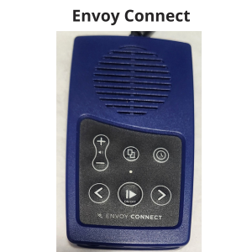
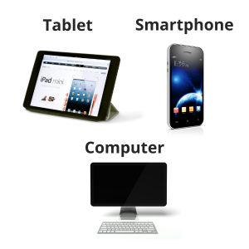
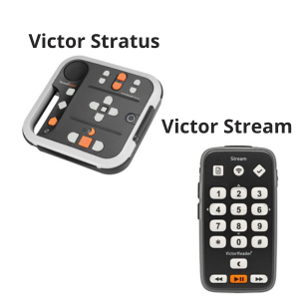
Audiobook player options
Notes:
We’ll describe the most popular audiobook player options that play CELA’s books and magazines.

Slide 11
Envoy Connect

Slide 12
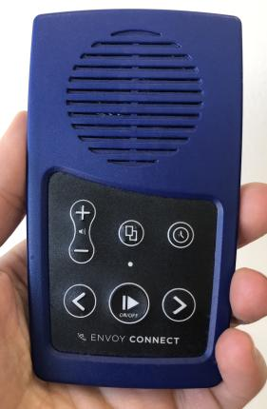
Envoy Connect player
Audiobooks only
Direct to player bookshelf
Add/remove books by:
  Using the CELA Connect app on a computer
  Patrons can mail back player to CELA to reload
CNIB Smartlife $97
Notes:
The Envoy Connect device is another way for your patrons to access CELA books. Envoy Connect is an easy to use, portable, and affordable option for reading accessible audiobooks. it can be reloaded by downloading books or magazines directly from the patron’s CELA Direct to Player bookshelf with our software called, CELA Connect.
Many public libraries are loaning out Envoy Connect devices and loading books for people with print disabilities. This option is becoming more popular with libraries who are seeking newer and less expensive ways to offer reading devices.

Slide 13
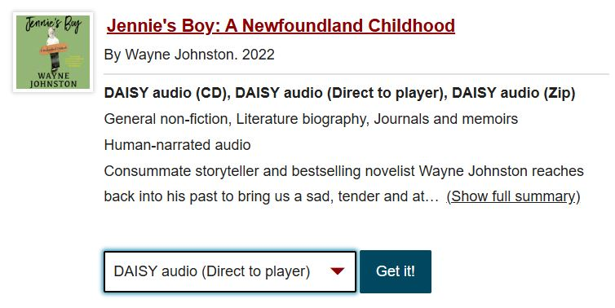
Choose books and magazines
1. Visit celalibrary.ca
2. Log into your main CELA account
3. Find books or magazine issues
4. Choose format: DAISY audio (Direct to player)
5. Item on Direct to player bookshelf
Notes:
Before loading your players, you will need to choose books and/or magazines to add to your Direct to Player bookshelf. Select the format: DAISY audio (Direct to Player). Wait a few minutes and go to "My account" and open your Direct to Player bookshelf to check that they have been added.
You can also receive an email letting you know when the book is on bookshelf. To set this up, go to My Account and select Communication preferences.

Slide 14
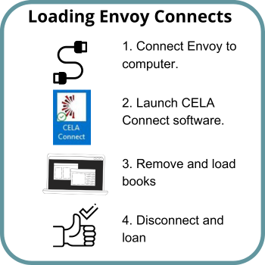
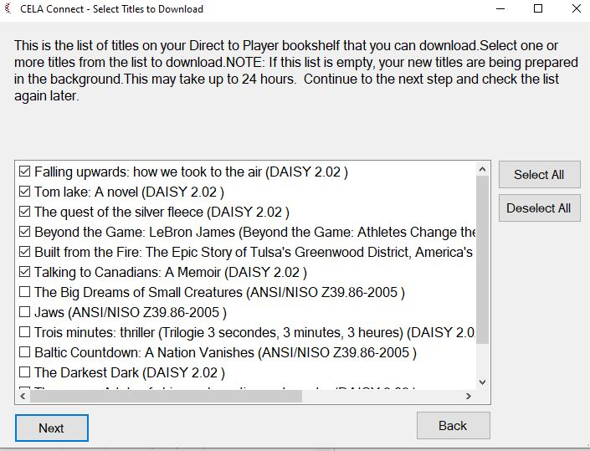
CELA Connect
Notes:
First install the free CELA connect software on library computers you will use to load the players. You may share your CELA account login with staff so this can be done on more than one computer. You can also load books or magazines onto more than one player.
We’ll describe and show you how you load books onto your Envoy Connect in the video we’ll play on the next slide.

Slide 15
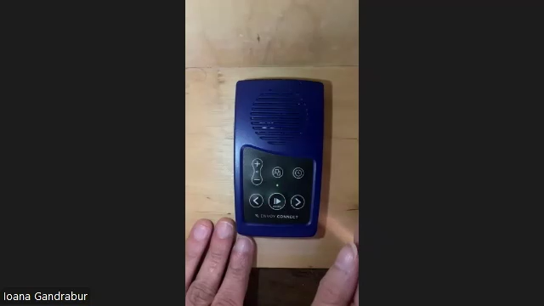
Envoy Connect and CELA Connect

Slide 16
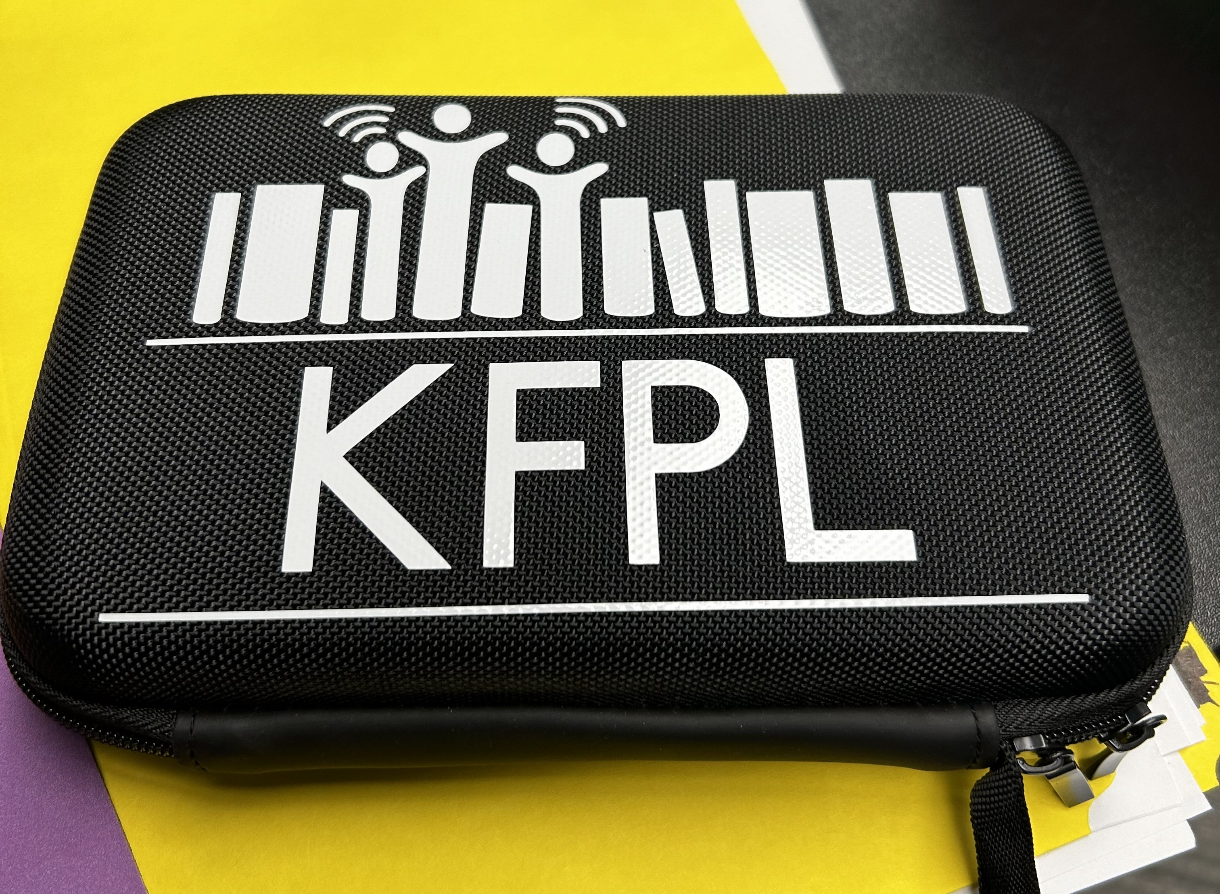
Loaning Envoy Connect devices
Create Envoy Connect kit:
Includes: micro USB cable, headphones and a lanyard
Libraries may consider providing:
Storage case
Additional micro-USB cords
Additional wall charging plugs
Notes:
We’ve received some helpful tips from libraries who have purchased several Envoy Connect players and circulated them to their patrons. When you order the player, it comes with a micro USB cable, headphones and a wrist lanyard. Libraries have recommended purchasing a storage case so you can include all these items together. They also recommend purchasing additional micro-USB cords as these can get lost, as well as wall charging plugs so patrons can charge their player at home.

Slide 17
Dolphin EasyReader app

Slide 18
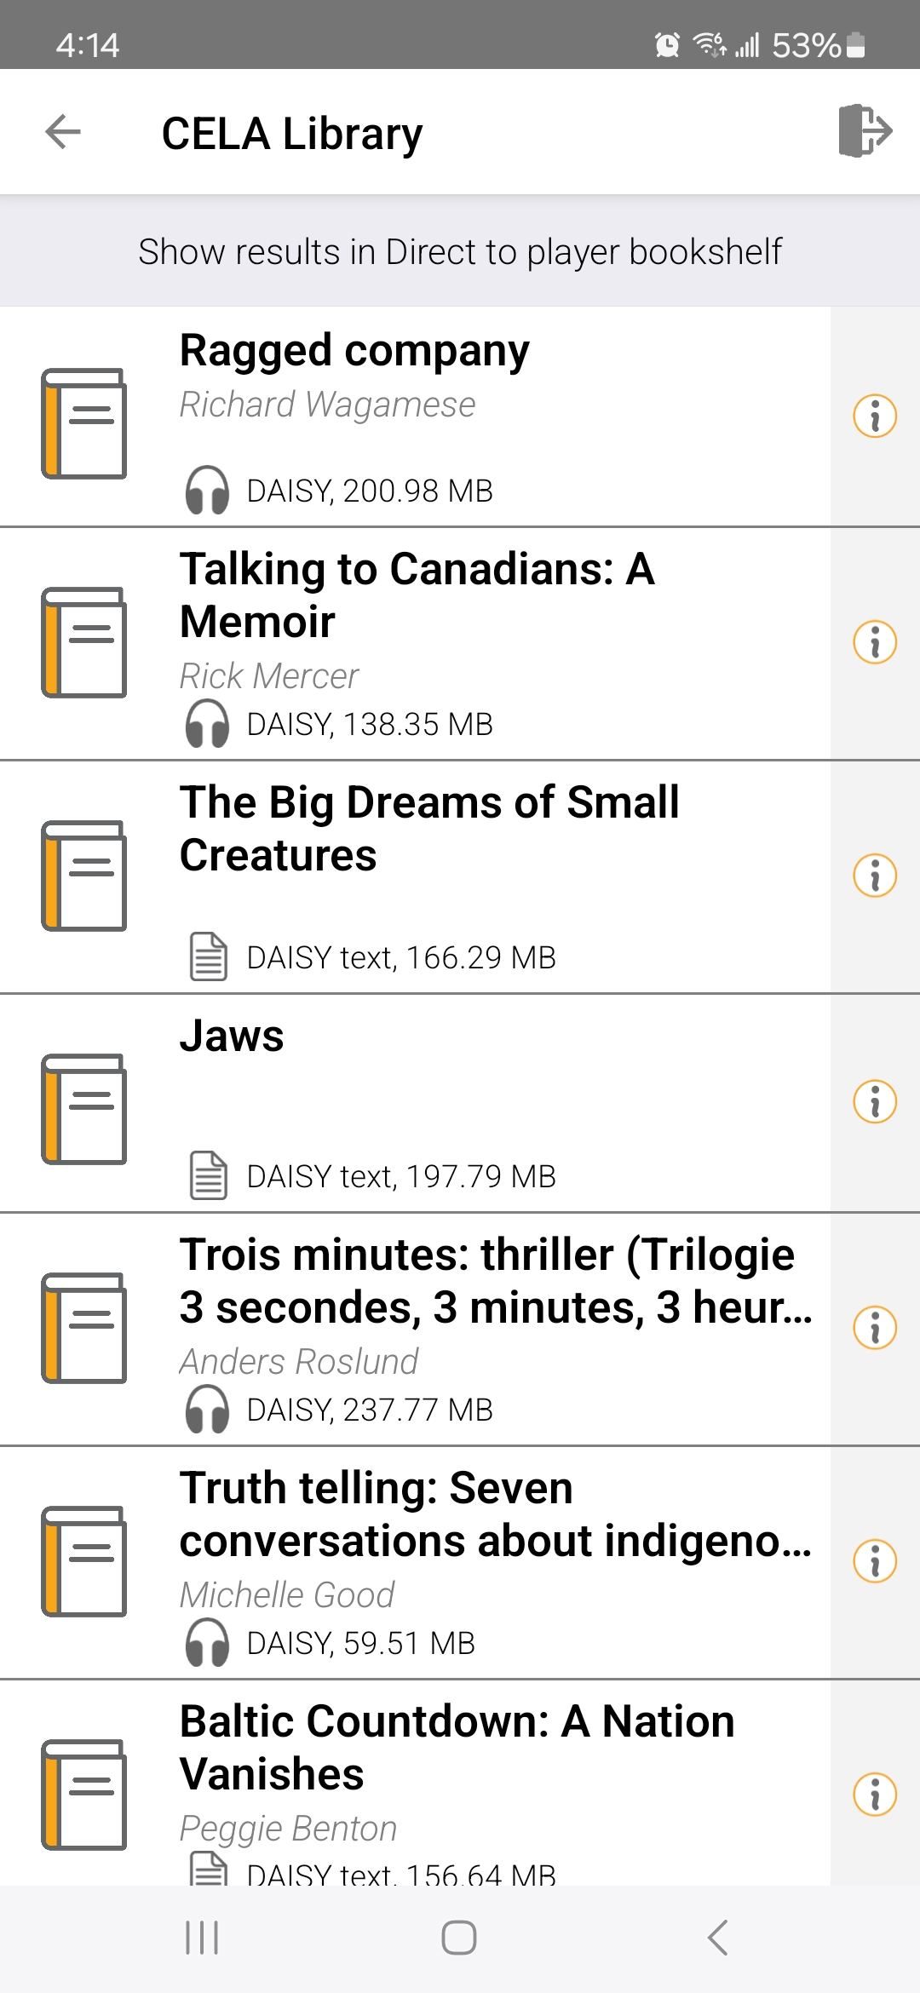
Dolphin EasyReader
Dolphin EasyReader app to read audiobooks or e-text
Delivery options:
  Direct to player (loads books directly onto app)
  ZIP files
Free app
Annual Premium version $49.99
Notes:
If you loan tablets, you may wish to add the EasyReader app.
The app that works with our Direct to player service and is available for Apple and Android devices, as well as on desktops or laptops. The app is free and you can search our catalogue on the app and add books and magazines to the bookshelf. If you select books using our site, we recommend selecting the Direct to player format for audio or text since this simply loads the book straight onto the app. If you’d like to have more options, such as synching books across all your devices with the app, you can pay for the Premium edition which costs $49.99 CDN per year.
You can also access our books and magazines as ZIP files for DAISY audio, several e-text formats and electronic braille files. Using the ZIP file will give you the option read our books on many different apps, including VoiceDream app, Google Read&Write plus many more.

Slide 19
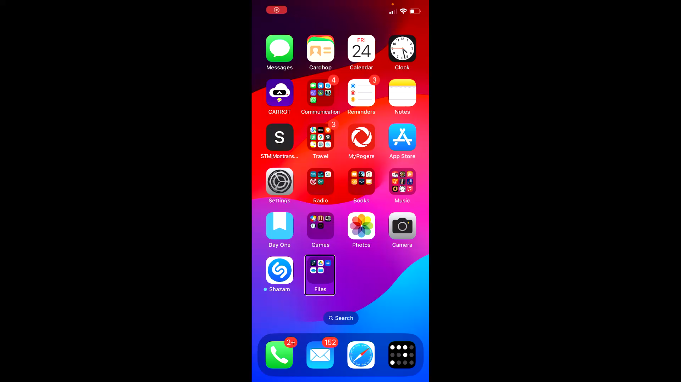
EasyReader app

Slide 20
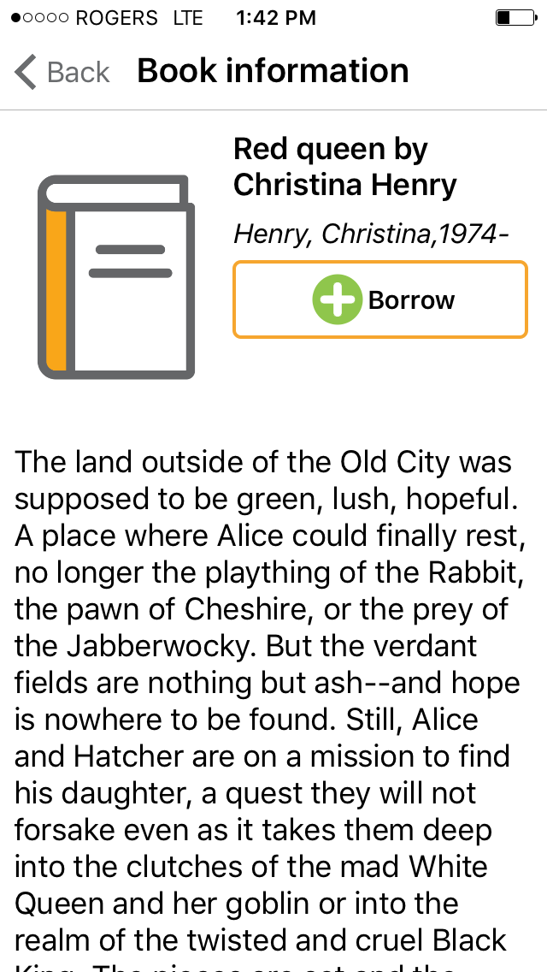
Loaning tablets with EasyReader app
Libraries may add the app to multiple devices
Bookshelf is shared and same books appear on every device with the app
Download title so can’t be deleted off of the device
Only loan tablets to patrons with print disabilities

Slide 21
DAISY players

Slide 22
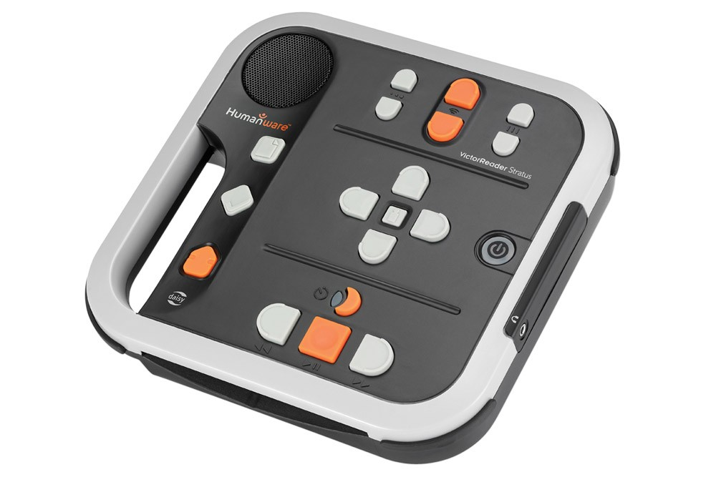
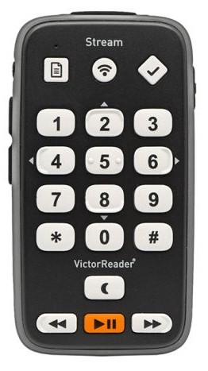
DAISY players
HumanWare Victor Stratus or Stream
Books added straight to the player through your internet connection
Direct delivery to the player
Stratus $655.00
Stream $595.00
Notes:
The next device we’ll review is a DAISY player. Many of you may have a Humanware Victor Stratus or Victor Stream player which you may loan. The Victor Stratus has a CD slot that can be used to play music CDs, CELA DAISY CDs or other audiobook CDs in your collection. Both models can be configured to connect to a local wifi connection so books are loaded straight onto your player from your Direct to player bookshelf. If you have a stable internet connection through wifi, then Direct to Player service is a good option.
You can also load a book or magazine ZIP file by connecting the player to a computer or using an SD card.
These players are sold through CNIB Smartlife, or through the manufacturer, Humanware for $655 for the Stratus, and $595 for the Stream.

Slide 23
Configuring Wi-Fi DAISY players
Steps
Players
Determine if your player is Wi-Fi enabled.
Press Info key on 4M to hear firmware version.
Contact help@celalibrary.ca
Wi-Fi-enabled:
HumanWare Victor Stratus 4M or 12M
Victor Stream
No Wi-Fi:
HumanWare Victor Classic
Does not work on Plextalk players
Notes:
Libraries in Ontario and Alberta may have received a Victor Classic Player from CNIB about 14 years ago. While they can play CDs, they are not wifi-enabled.

Slide 24
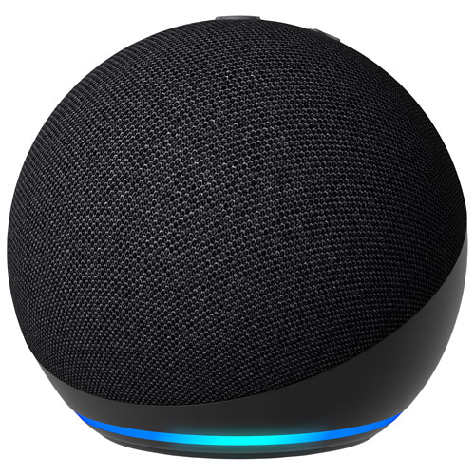

Coming soon…voice control
Amazon Alexa Smart speaker:
Accessible Reading Canada Skill
Notes:
As we’re saying farewell to older technology, we’re also very excited to tell you that we’re planning for the future. Your patrons will soon be able to access books on an Amazon Alexa smart speaker. We’ve been testing the ability to choose, operate and hear CELA audiobooks on the Accessible Reading Canada Skill. You may ask why we didn’t call this the CELA skill, but we chose this name because CELA in French is “CAÉB” and when we said “BiblioCAÉB” to Alexa, it misheard it and thought we were saying “Caribbean”.
I’m now going to play an audio demo of our staff member, Ioana opening the app, using the menu options such as resuming a book and going through the player options.

Slide 25
Book clubs
Add the same book to multiple Envoy Connect devices
Add to DAISY players using an SD card or Direct to Player
Suggest members register for CELA and request their own copy

Slide 26
Last word - encouraging patrons to switch to a new device
If patrons wish to configure their own player, they only need to learn one new button.
Tell family and friends that CELA books can be downloaded to a USB stick or SD card and added to a DAISY player.
Promote that patrons can send back their own Envoy Connects for reloading.

Slide 27

We can help!
Book appointment for 1x1 phone help
Join training webinars
Learn more about our support through our Open Book for Libraries newsletter.
Notes:
We can provide further support to you through Member Services. Please call us to make changes to your account information, help with ordering books, and also for help with the apps and devices that play our books.
The last item to mention is our monthly newsletter called Open Book for Libraries, that provides news regarding new titles we’ve added, any service announcements and the upcoming webinars for that month. We encourage you to subscribe if you haven’t already.

Slide 28
Connect with CELA
Visit celalibrary.ca
Member Services: 1-855-655-2273, ext. 2 or members@celalibrary.ca
Thank you!
Notes:
If you have a question about your service, please reach out to the CELA Member Services staff.

