Slide 1
Accessible Reading Canada
Webinar for Patrons and Libraries

Slide 2
Housekeeping
Introductions
Asking Questions
Accessibility Features in Zoom
Tech Issues
Webinar Recording
Survey

Slide 3

Land acknowledgement
I live and work in Toronto, the traditional territory of many nations including the Mississaugas of the Credit, the Anishnabeg, the Chippewa, the Haudenosaunee, and the Wendat peoples. This territory is now home to many diverse First Nations, Inuit and Métis peoples. This land is covered by Treaty 13 with the Mississaugas of the Credit.
Wherever we find ourselves today, across Turtle Island, we can be grateful to the First Nations for their careful stewardship of the land.

Slide 4
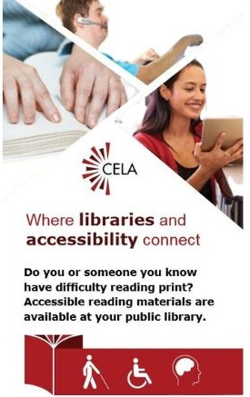
What is CELA?
Is a free library service offered through Canadian public libraries
Serves people with print disabilities across Canada
Provides materials in accessible formats, like braille, e-text and audio
Notes:
CELA is a comprehensive accessible library service, providing over 1,000,000 books, magazines and newspapers to people with print disabilities living in Canada. CELA is a national not-for-profit organization that provides accessible reading services to the approximately 3 million people across Canada with print disabilities. Our services ensure that people with print disabilities across the country are more able to fully participate in learning, work and community life and contribute to the social, cultural, and economic development and success of their local and broader communities.
Print disabilities encompass those who are blind or visually impaired, people with comprehension disabilities such as dyslexia and those with physical disabilities that make it difficult to read a print book.
Our mission is to support public libraries in the provision of accessible library collections and to champion the fundamental right of Canadians with print disabilities to access media and reading materials in the format of their choice.

Slide 5
Agenda
Alexa Smart Speakers
Accessible Reading Canada (ARC) Overview
How the Skill Works
How to get help
Questions

Slide 6
Alexa Smart Speakers

Slide 7
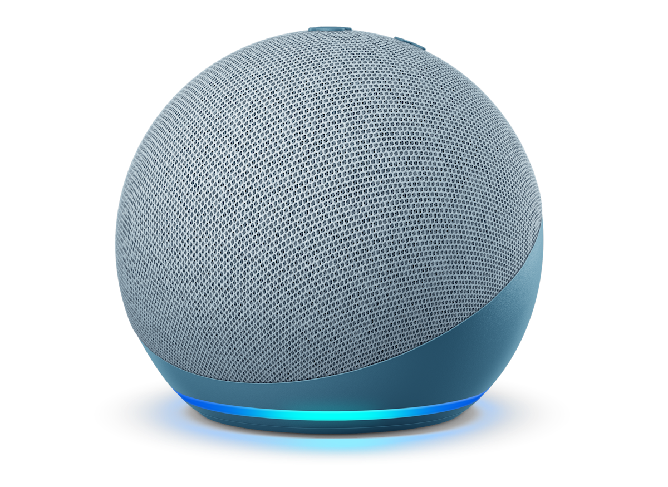
About Alexa Smart Speakers
A speaker that operates with Amazon’s voice-controlled assistant, Alexa.
Allows users to give voice commands to:
control music playback
manage smart home devices,
get information
Most prices ranges from $40-$100
Notes:
Alexa-enabled smart speakers are devices, primarily from Amazon, that combine a speaker with Amazon's virtual assistant, Alexa. Amazon’s smart speakers are called Echos, but there are other kinds of speakers that are Alexa-enabled.
Users must have an Alexa-enabled device to use the CELA skill. We recommend Echo Dots as they’re inexpensive and easy to use.

Slide 8
Where to buy an Alexa smart speaker
Online retailers
  Amazon Canada website
  Newegg
Electronics retailers
  Best Buy
  Canada Computers
  Staples
Home Improvement retailers
  Canadian Tire
  Home Depot
Other retailers
  Walmart
  Shoppers Drug Mart / Pharmaprix
Notes:
Additional Home Improvement retailers:
Rona
Lowe’s

Slide 9
Accessible Reading Canada (ARC)

Slide 10

About Accessible Reading Canada
Alexa skills are voice-activated apps that add new functionalities to an Alexa-enabled device.
Accessible Reading Canada is a free Alexa skill that allows CELA users to read audiobooks on an Alexa smart speaker.
Available in English and French.
Notes:
Alexa skills work similarly to a browser extension or phone app.

Slide 11
How ARC Works

Slide 12
Connecting to CELA
Launch skill
  Alexa app
  Amazon Website
Log into CELA account
Use command list to navigate skill

Slide 13
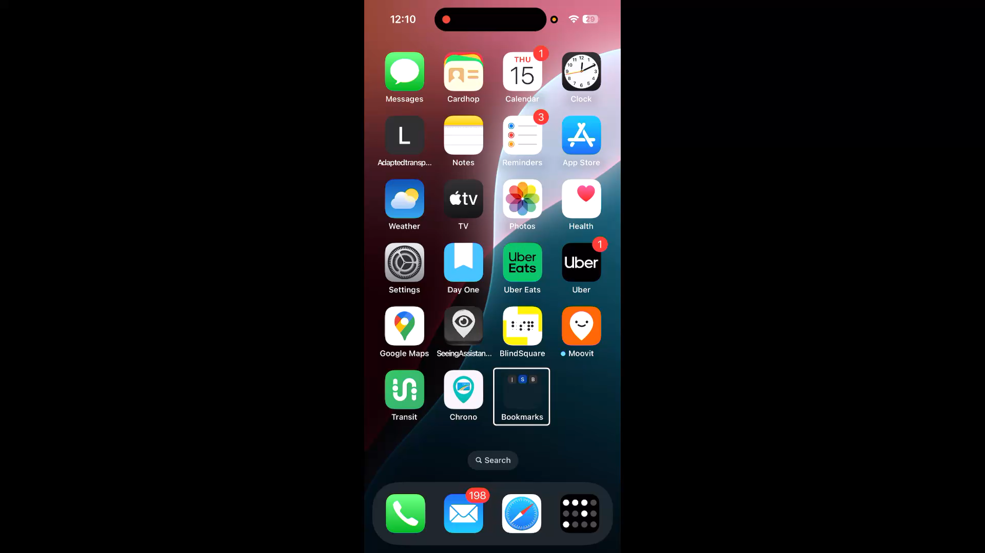
Enabling the ARC Skill Demo
Notes:
Video: Manually enabling CELA skill with a screen reader.
When you first open the app before it has been launched or linked, you cannot use the phrase “Start accessible reading Canada”.
You have to use “Open” or “Launch Accessible Reading Canada”. Otherwise, the speaker does not understand what you're trying to do.
In the Amazon app on iOS. Swiping left and right to locate an element such as the notification from Alexa doesn't work very well. What works better is dragging your finger across the screen and physically locating the notification.

Slide 14
Skill Menu
Books in Progress
My Books
Browse Library
Resumes your most recently played book
Playback
  Navigate chapters
  Increase volume
  Ask Alexa for info
  Quit/Stop
Books in Progress
  Hear a list of up to 4 recent books you started reading to on the skill
Bookshelf
  Lists books on your CELA Direct to Player bookshelf
Search
  Search for books by title, or title and author
Recommend Books
  Hear a short list of staff selected books
Notes:
The skill menu is announced after linking your account and launching app. Users can jump from submenus back to main menus or other submenus.

Slide 15
How to add Books to ARC skill bookshelf
Choose DAISY audio
(Direct to Player)
format
Title appears on CELA account bookshelf
User can access title on smart speaker via ARC skill
Notes:
Direct to Player Bookshelf is linked to the ARC skill
Users can only access audiobooks from CELA
not from Bookshare or magazines
nothing with text-based books

Slide 16
ARC Bookshelf
Direct to Player Bookshelf is linked to the ARC skill
  titles played through the app will appear in patron history
Users can access human-narrated audiobooks from CELA
  not from Bookshare or magazines
  nothing with text-based books

Slide 17
ARC Commands
Link: Command List (Word)
Navigation Commands
Launch/Open
Next/Previous
Go back
First
Main Menu
Stop/Quit
Additional Commands
Resume
Read/Start Reading
My Books
Search
Recommended Books
Summary
Repeat
Help

Slide 18
Navigation
Alexa’s prompts should indicate command options
  Users can always use “help” command
Users can use “stacked commands”
  Ask Alexa to perform sequential commands
  “Alexa, launch Accessible Reading Canada and search The Hunger Games”
Notes:
Users can use help command in any menu of the skill, except for playback. The help command is contextual. For example, while in the search menu, the help command tells you how to complete a search.

Slide 19

ARC Demo

Slide 20
Playback
After entering the playback of a book, users are no longer in the Accessible Reading Canada skill
Starting playback enters Alexa’s playback function
  Users must restart the app to exit playback
  The “help” command is not available during playback
Alexa controls the functions in playback, not ARC
Notes:
Once you enter playback of a book, you are no longer in Accessible Reading Canada, you’re in Alexa’s playback function and you have to restart the app. Alexa controls the functions in playback, not ARC.

Slide 21
ARC Review

Slide 22

What ARC can do
Play human-narrated books from CELA
Navigate tracks in order, using previous or next
Return to your where you were previously reading on smart speaker
Read book summaries
Perform ‘stacked’ commands
Move backwards and forwards in the menu structure and return to “Main Menu” any time

Slide 23

What ARC cannot do
Page or heading navigation
Adjust playback speed
Sync with other reading apps or devices (Victor Stream, Dolphin EasyReader)
Search is very basic, no filters
Read e-text, books from Bookshare or magazines
No ability to remove books from D2P bookshelf via skill
Notes:
The ARC skill cannot navigate to specific pages or sections within chapters. Users cannot add books to their D2P bookshelf with the skill, however, starting a book through the skill will add the title to their “history” tab on the CELA website.

Slide 24
How to Get Help

Slide 25
Who can you call?
Amazon Support
CELA Contact Centre
Initial Smart Speaker setup help
Tech issues outside of the skill
Privacy-related questions
General questions about Accessible Reading Canada
Bug reports for the skill

Slide 26
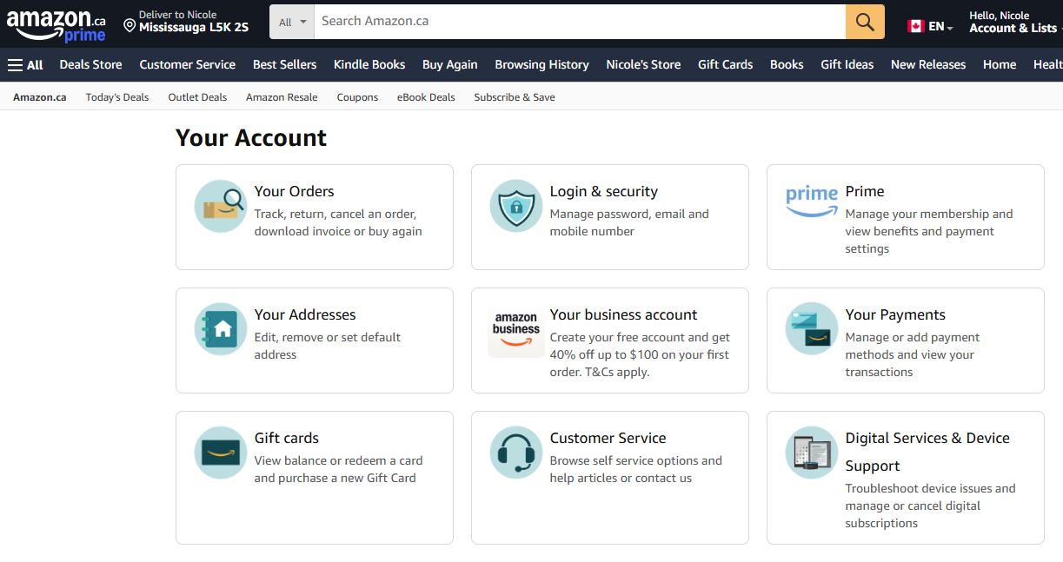
Amazon Support
Select Amazon Account on website (“Hello, _____”)
  Digital Services and Device Support
    Amazon Alexa Accessibility Help
  Customer Service
Notes:
Amazon Digital Services and Device Support includes:
Articles
Community Forum
Chat service

Slide 27

We can help!
Call our Contact Centre for 1x1 phone help
Join live training webinars
Check out the Accessible Reading Canada Help page
  User Guide
  Video Tutorials
  Audio Demos

Slide 28
Connect with CELA
Visit www.celalibrary.ca
CELA service call: 1-855-655-2273
CELA email: help@celalibrary.ca
Thank you!

