Slide 1
Accessible Reading Technologies

Slide 2
Agenda
What are print disabilities?
What does accessible reading technology really mean?
Accessible formats
Types of accessible reading tech
Text to Speech software
Literacy support software
Braille Displays
Screen Magnifiers
DAISY players and more affordable audiobook players.
Voice-activated devices
Accessible reading apps
Where to learn more
Notes:
What is really ideal is to watch users of these technologies and try them for yourselves, so to simulate that as best I can in a webinar, I will show lots of short videos of people using the tech I'm talking about, and I will tell you how you can try them for yourself if there are relatively easy ways to do so. I really encourage you to spend some time using these technologies so you have an appreciation for how they work.
Not an in depth tutorial on any reading technology, but I hope enough to orient library staff to what options exist, what CELA formats they work with and where you can learn more or try for yourself.

Slide 3
Print disabilities
A print disability is a condition that prevents a person from reading ordinary print.
3 types mentioned in Canadian Copyright Act:
visual disabilities
physical disabilities preventing a person from holding a book and turning pages
'impairment relating to comprehension', most commonly learning disabilities such as dyslexia
Notes:
A print disability is simply a condition that prevents a person from reading ordinary print. For us in Canada, the Canadian Copyright Act defines more specifically the three types of print disability which can qualify a person for access to alternate format materials. These types of disability are
1. visual disabilities, and include not just blindness or low vision, but also the inability to focus or move the eyes.
2. Inability to hold a book or turn pages -- physical conditions affecting use of the hands, ex paralysis, CP, MS, severe arthritis etc.
3. 'impairment relating to comprehension', most commonly learning disabilities such as dyslexia. Here there are differences in the brain that prevent an individual from processing print.
These conditions can be combined, and can also be temporary, ex. Cataracts.

Slide 4
What does accessible reading technology really mean?
Accessible discovery & delivery
Library catalogue
Econtent provider
Accessible content
Accessible ePub
Accessible playback/reader systems
Reading systems with accessibility features
Search & discovery in apps/reading system
Audio
Braille
Examples: apps, braille displays, DAISY players
Notes:
Accessible formats or content alone are not enough, The complete process of finding, acquiring, reading a book must be accessible.
So, the website, database, catalogue that you use to find and acquire the book must be accessible. For example, we need to look at whether library websites, catalogues, econtent providers websites, apps, etc. -- all the places where you search or browse for books and select them – are accessible.
The content needs to be accessible, of course. This means formats that the books are in need to be accessible; that is readable by people with a print disability or with assistive technology. List examples.
The reader/app/software/player that you use to read the content also needs to be accessible.
For example, an app should work with the built in screenreader in the phone or tablet.
Accessibility is not one-size fits all; different people will have different needs. Generally though choice of formats and well-structured machine-readable content that can be interpreted by assisted technology will go a long way.

Slide 5
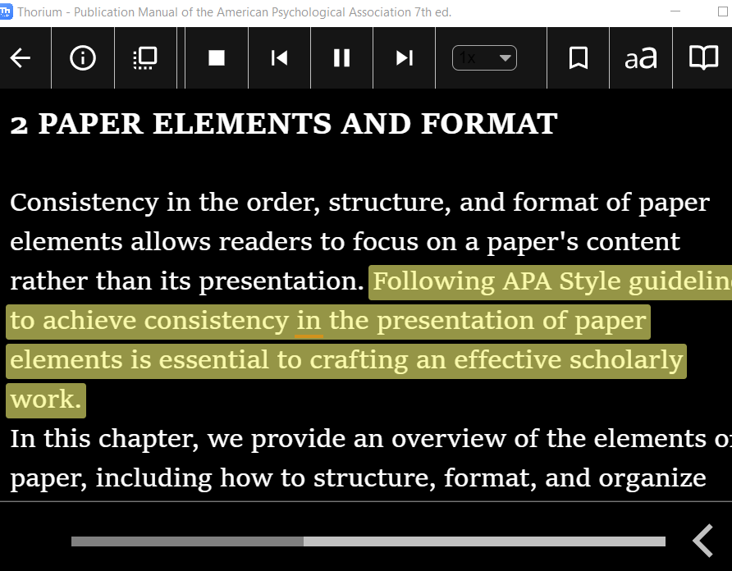
Accessible formats (1 of 3)
Text formats - accessible ePub3, DAISY text, Word
These text formats allow people to use various assistive tech to read them, including magnification and text to speech
ePub3 includes structure, navigation, option to include other media such as audio, potential to make dynamic content accessible
Notes:
Standard non-proprietary ebook format is epub; and it has evolved over the years. Most recent standard is epub3 which allows ebooks to be fully accessible, include media such as audio and video, good navigation, among other improvements. Epub standard is now maintained by the W3C consortium which is also responsible for maintaining web standards. One of the key benefits of EPUB3 vs. EPUB2 are the better accessibility standards.
Some ereaders do not support epub3 so uptake has been a bit slow. However, the main accessible reading apps do work withmost features of epub3.
DAISY is a format many of us know as the main format for people with print disabilities. We associate this format with audio CDs and DAISY players. DAISY books are still offered that way, but more and more users are downloading DAISY books, and using both audio and text. DAISY text can be read out loud with synthetic speech or read using a braille display.
EPUB3 and DAISY text are essentially the same format

Slide 6
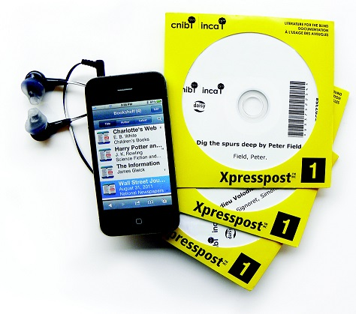
Accessible formats (2 of 3)
Audio formats – DAISY audio
specialized format for people with print disabilities; structured and navigable audio documents.
Audio can be human-narrated or generated automatically using synthetic speech
Important for leisure reading
Notes:
Audio books are another accessible format enjoyed by readers, whether they have a disability or not. CELA’s accessible audio books are in DAISY format and are designed and intended for the use of people with print disabilities. Depending on the contents of the book, they can be set up with very detailed structure, including chapters, headings, sub-headings and page numbers.
DAISY audio.

Slide 7
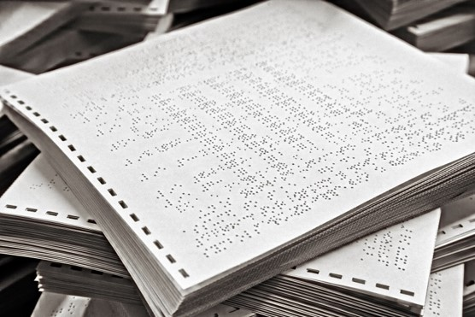
Accessible formats (3 of 3)
Braille and electronic braille
Braille tactile reading medium.
Electronic braille (.brf format) can be read on an electronic braille display
Braille can include tables, graphs, mathematical, scientific information
Notes:
Braille is the original accessible format, right? It can be embossed on paper, but can also be used with electronic devices called braille displays.
Something important to note when we're talking about accessible formats. Some materials can be made accessible relatively easily and cheaply, for example, a novel might need very little work to make a braille or DAISY text book, depending on how the publisher creates the original file. However, complex materials like charts, tables, graphs, music, math are all often rendered as images in publisher files and it takes a lot of human work to make those accessible. Bookshare for example converts publisher files automatically to braille and often graphical material is not represented well or is lost entirely in the automated braille transcription process.

Slide 8
Accessible reading technologies: screen readers
Screen readers convey information normally presented on the screen through synthetic voice and allow users to interact with a computer using keyboard only.
JAWS (stands for Job Access with Speech)
NVDA (free)
VoiceOver on Macs
Live Demonstration of how JAWS can be used to launch the CELA Website on Microsoft Edge.
You probably have a screen reader in your pocket!
VoiceOver in iOS, Talkback on Android
Turn on in Accessibility settings (but first learn how to turn off with gestures so you don’t get stuck!)
Notes:
Screen readers have been around a long time and form the basis of a lot of other accessible reading tech, so that's why I'll deal with them first.
Most popular is JAWS for Windows, but there are others. Including NVDA which is free.
I encourage you to try using a screen reader for a while and see what it's like to interact with devices with audio, not visual information. Keep in mind you won't have any idea what you're doing and will find it frustrating, while people who use screen readers everyday are pros, but you might find barriers on websites or apps you use that you didn't know were there. Keep some instructions handy so you know the basic commands or gestures to use.
I want to show you a video of someone using a screen reader. You can hear the screen reader running and he explains a bit about what information he's getting.

Slide 9
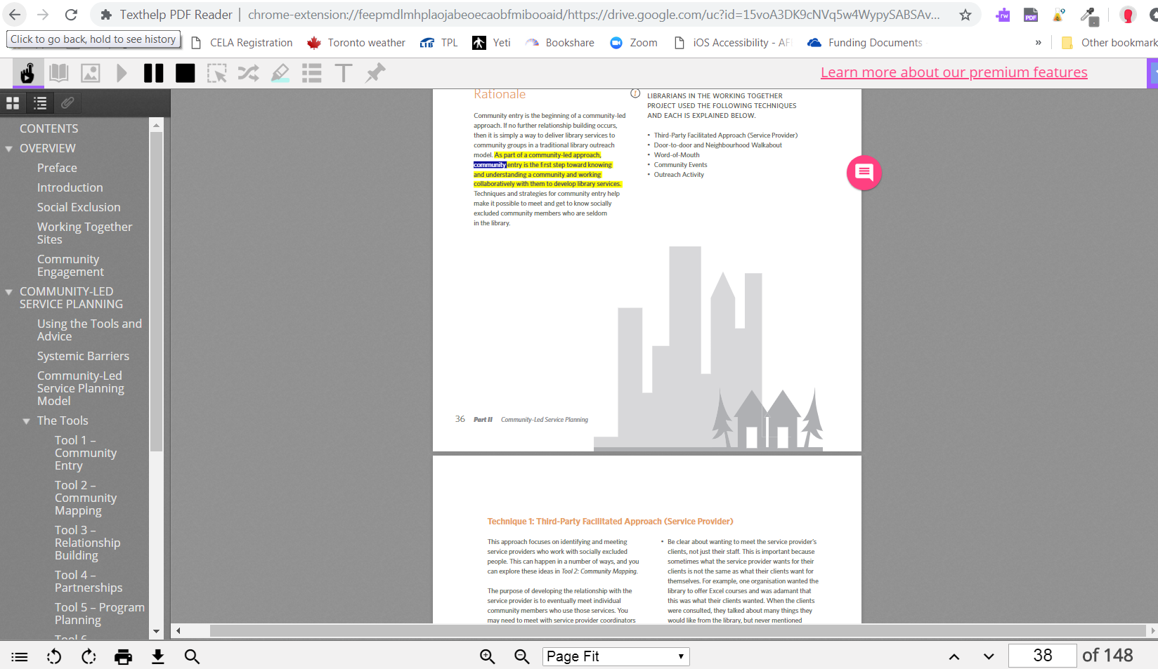
Accessible reading technologies: literacy support software
Software that supports people with dyslexia in reading more efficiently and effectively
Text-to-speech, word/sentence etc. Highlighting, word look up, writing assistance
Example: Read&Write extension for Google Chrome
Demo video for Read&Write
Notes:
You can use a free version of Read and Write for Google Chrome to get a sense of how this software works. And I'll show you a short video of a teacher using it to read a PDF.

Slide 10
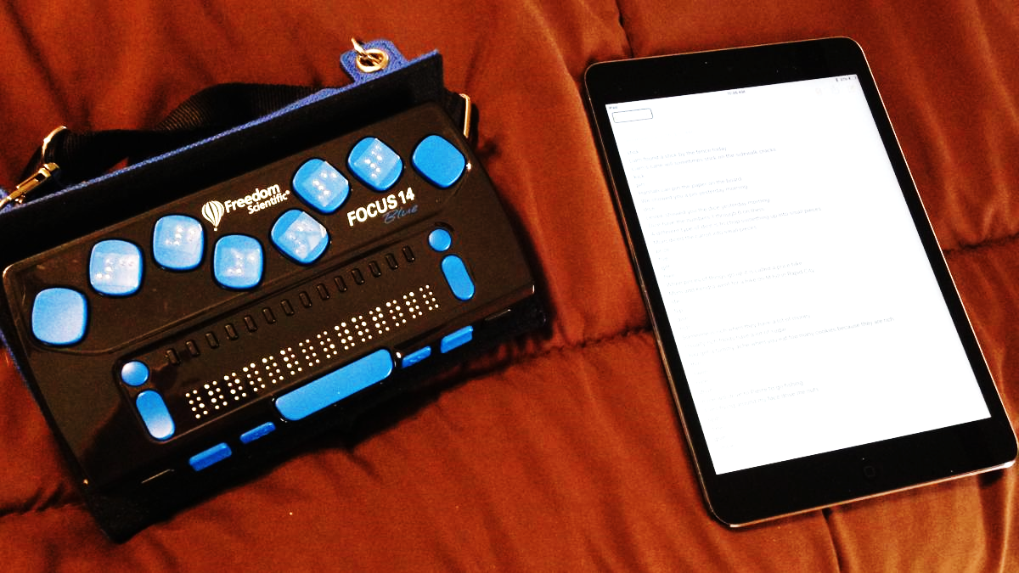
Accessible reading technologies: braille displays
Braille displays can be stand-alone device and/or connect to a computer or phone
Generally, braille displays are very expensive ($1000+) but work happening on cheaper displays
Text or electronic braille can be output to display
Demo video of braille display
Notes:
Braille displays are devices that render either text or electronic braille files as braille. In the case of text, the software they work with converts the text to braille and then the words are displayed in braille. Only a certain portion of the text can appear at once, and as the user 'scrolls' down, the braille refreshes and new text appears. Braille displays are generally expensive, but currently there's quite a bit of work being done internationally on making cheaper and bigger braille displays. Cheaper so more people have access to these important devices, and bigger so you can read more than a line or two of text at a time.
Honestly, I find this is one device where you have to see it working to really get it, so let's go to the video.

Slide 11
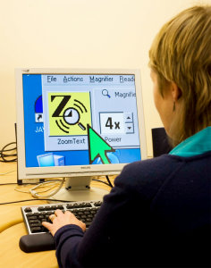
Accessible reading technologies: screen magnifiers
Popular screen magnifiers include ZoomText and Apple's built-in magnifier
CCTV magnify physical objects ex. mail
Features include very high magnification, changing contrast, basic text-to-speech
ZoomText demo video
Image from eaccessibilitywales.org.uk/
Notes:
Screen magnifiers allow low vision users to make the stuff, text and images on the screen bigger and more visible, by changing the colour contrast
Zoomtext also offers basic text to speech. So a user might turn that on to read a bigger chunk of text more easily.

Slide 12
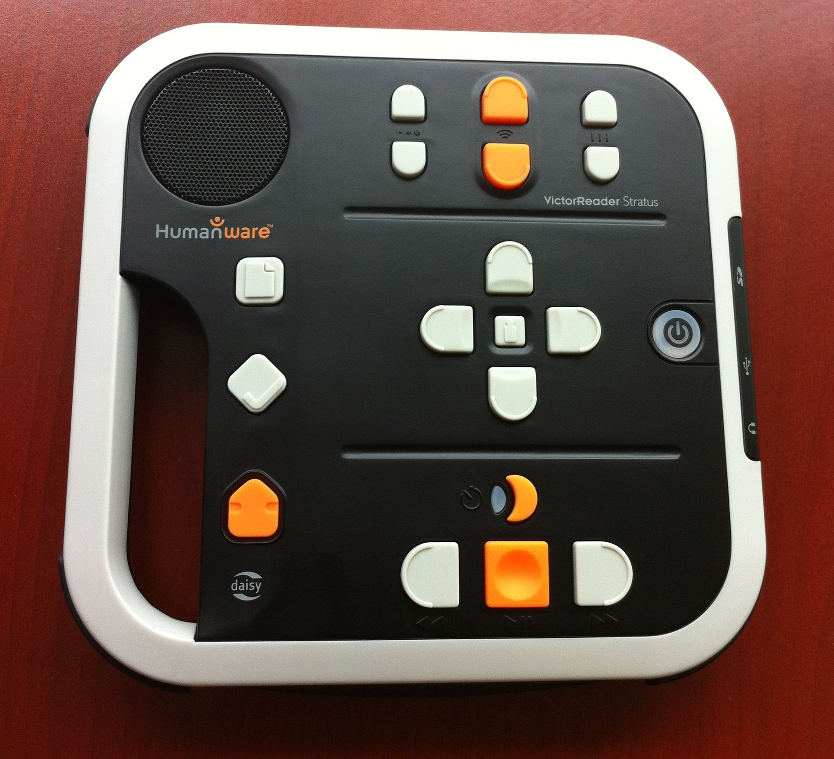
Accessible reading technologies: DAISY players
Specialized devices for reading accessible books, especially audio
Intended for users who are blind or have low vision
Brand sold in Canada is Humanware
CELA recently launched a much more affordable option that will also play well-structured DAISY books and other audio books called the Envoy Connect; it has been well received by participants.
Live demonstration of playing a book on Envoy Connect.
Notes:
DAISY players are probably the accessible reading device most public library staff are familiar with. They are designed for blind or low vision users with contrasting buttons, audio feedback on the buttons, and they have navigation keys that let you move through the DAISY book by heading, chapter, page, etc depending on how the book is set up. There are DAISY players that will take CDs and connect to the internet and, pocket versions that only connect to the internet.

Slide 13
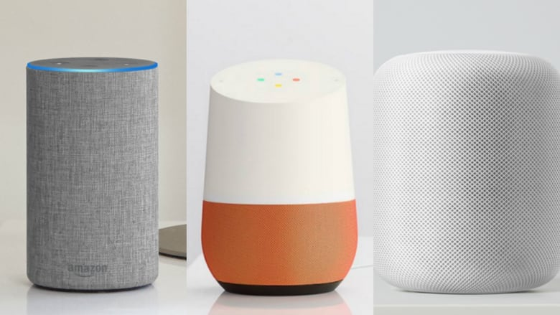
Voice-activated devices
Voice-activated devices (Amazon Echo, Google Home, Apple HomePod, etc) have huge potential for people with print disabilities
These devices can be accessible reading technology on their own or in combination with other devices
DAISY Consortium webinar on smart speakers
CELA is currently working on offering the ability to listen to audio books on the Alexa Smart Speaker for all patrons.
Notes:
Voice-activated devices (Amazon Echo, Google Home, Apple Alexa etc) have huge potential for people with print disabilities
These devices can be accessible reading technology on their own or in combination with other devices
We know from speaking with many of our own users that they are interested in reading with the help of these devices.
Recent DAISY Consortium webinar on smart speakers highlighted work of organizations like CELA in other countries. CELA is following work on voice activated devices with interest and is working on a solution using Amazon Alexa technology.

Slide 14
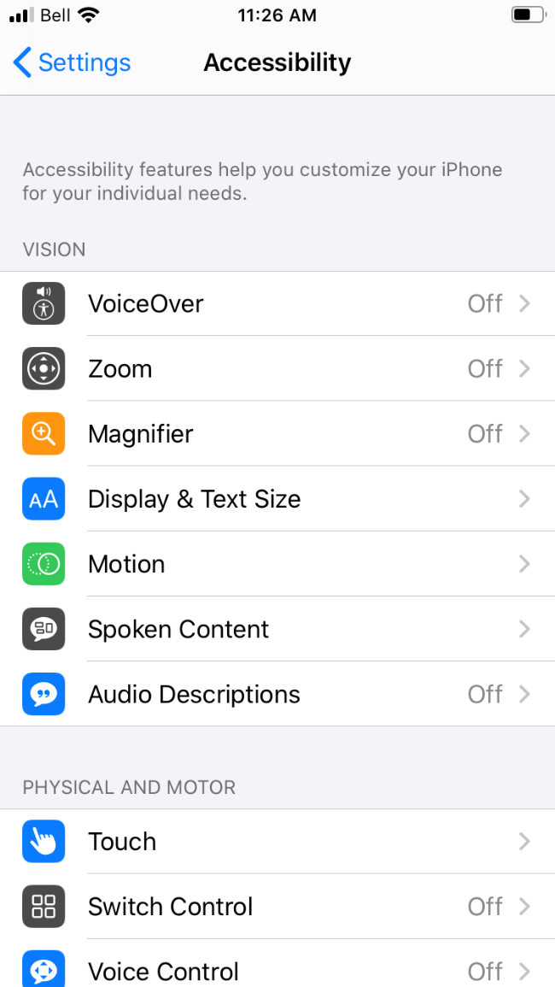
Accessible reading technologies: accessible reading apps
Smart phones & tablets have changed accessible reading options dramatically
Consider both mainstream reading apps & apps designed for accessibility
NNELS’s evaluations of popular library reading apps

Slide 15
Dolphin EasyReader and Voice Dream Reader
Dolphin EasyReader | Voice Dream Reader
iOS and Android | iOS and Android
Free | $21 for iOS; $14 for Android
Additional voices available for purchase | Additional voices available for purchase
DAISY audio, DAISY text, ePUB* | Many file formats, including DAISY audio, text, ePUB*
CELA Direct to Player | No CELA Direct to Player
*DRM-free ePUB only
Notes:
Comparison of 2 most popular accessible reading apps among our patrons, EasyReader and VoiceDream reader.
Generally I would suggest EasyReader is a good place to begin and is only app that works with Direct to Player, but many users find VoiceDream has powerful features they really appreciate.

Slide 16
Demonstration of accessible reading apps
Live demonstration of Dolphin EasyReader app on iPhone.
Live demonstration of Voice Dream Reader app on iPhone.

Slide 17
Reading tech accessible to those with motor or physical challenges
People living with motor or physical challenges have a variety of options for accessing book content, depending on their needs and preferences.
Modified keyboards can be used to accommodate for alternate ways of device interaction rather than a traditional keyboard.
Hand or head switches can be installed for easier device or app navigation as opposed to touch screen gestures or mouse clicks.
Voice Dictation facilitates navigation through spoken commands.
Eye-Gaze technologies facilitate navigation by tracking a person’s eye movement as they look towards their desired app, program or function.

Slide 18
Further resources
CELA Compatible devices page
CELA Accessible formats page
Accessible Publishing Resources page
Inclusive Publishing
Bookshare popular reading tools classified by type of disability
Understanding Assistive Technology: How Do People with Mobility Disabilities Use Technology?

